Slide 1





“Contaminanti presenti nei sedimenti dragati alterano il trascrittoma della vongola filippina e inducono cambiamenti nella composizione del microbiota”
Ilaria Bernardini, Andrea Quagliariello, Luca Peruzza, Maria Elena Martino, Giulia Dalla Rovere, Silvia Iori, Davide Asnicar, Maria Ciscato, Jacopo Fabrello, Fabiana Corami, Martina Cecchetto, Elisa Giubilato, Claudio Carrer, Cinzia Bettiol, Elena Semenzin, Antonio Marcomini, Valerio Matozzo, Luca Bargelloni, Tomaso Patarnello, Massimo Milan

Slide 2
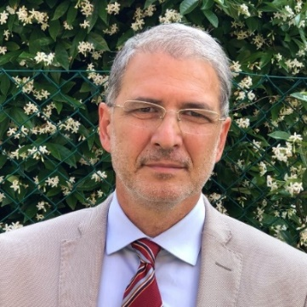
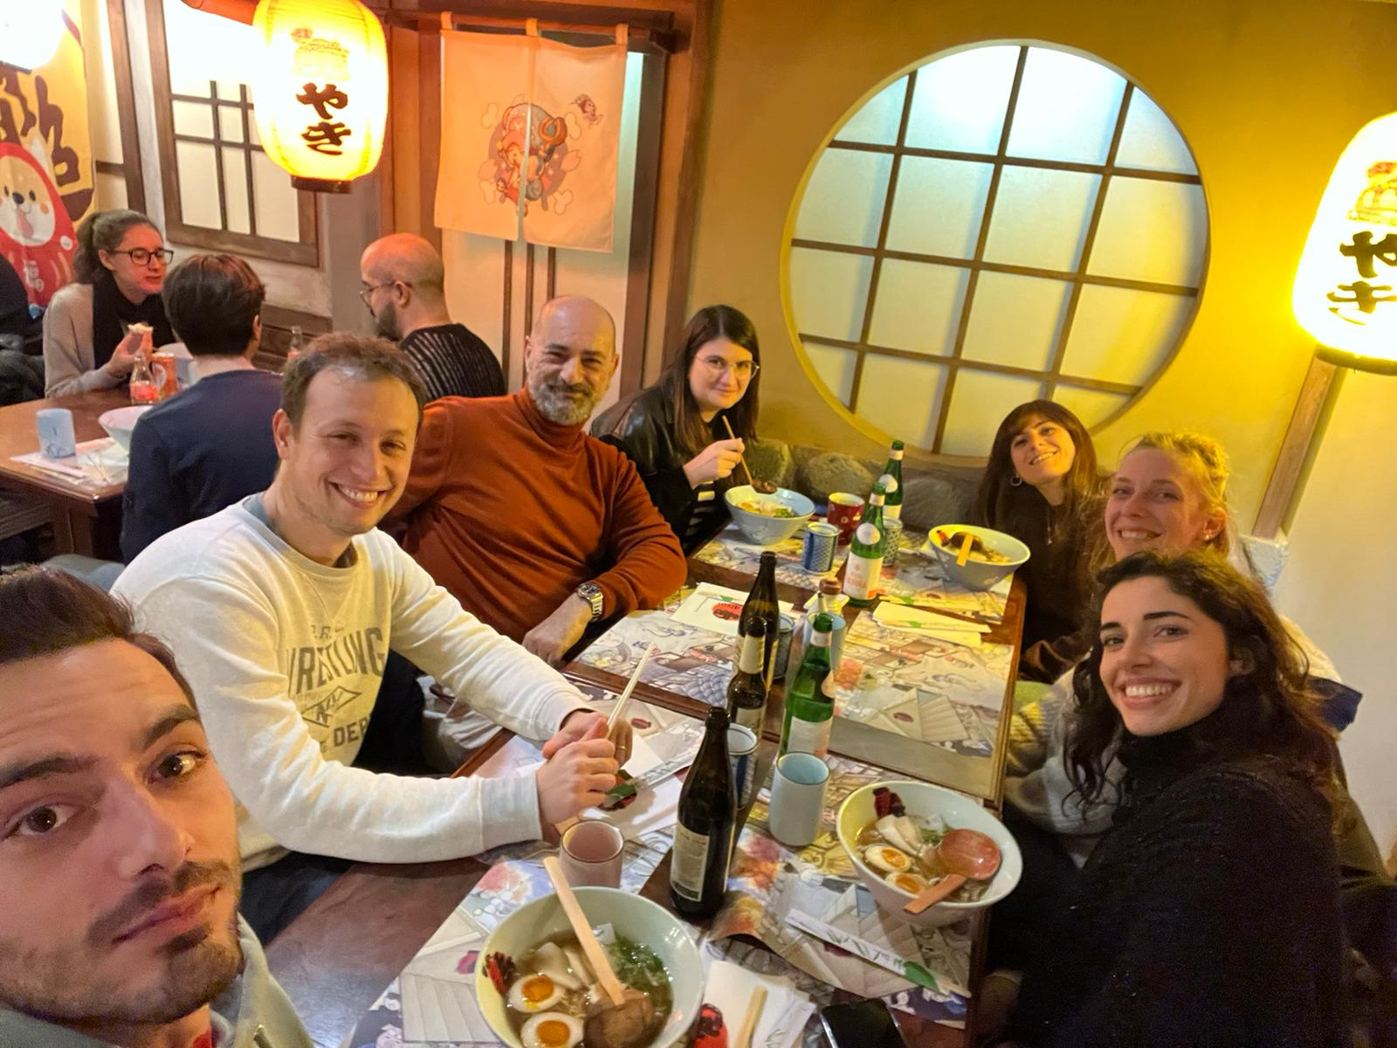

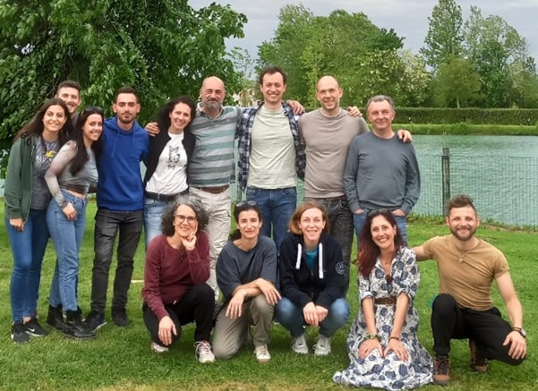
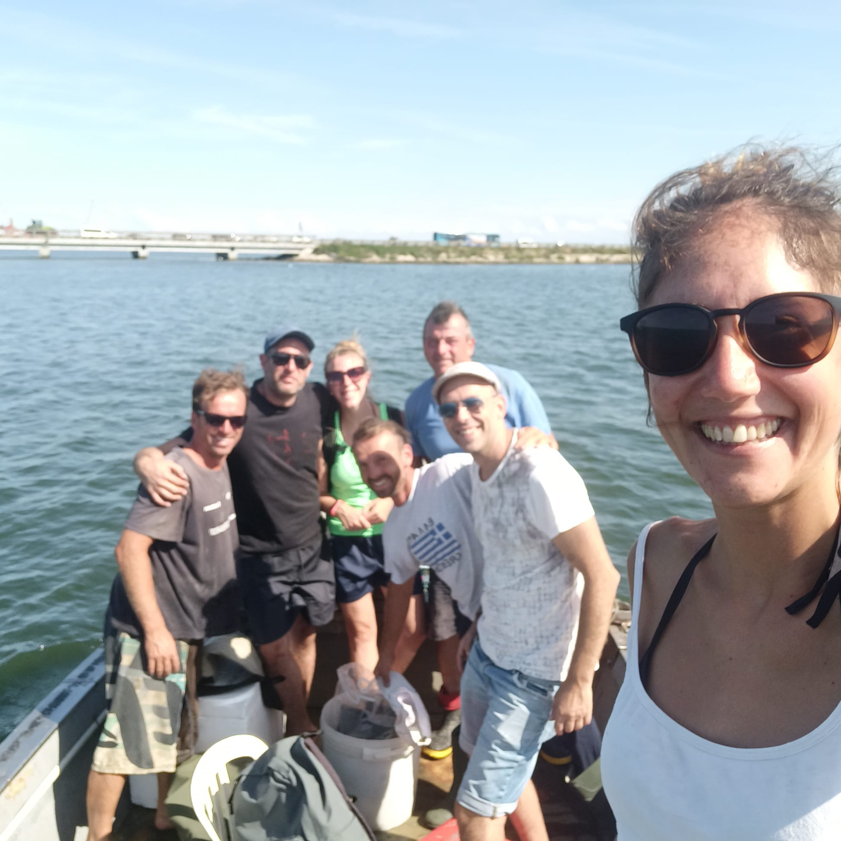
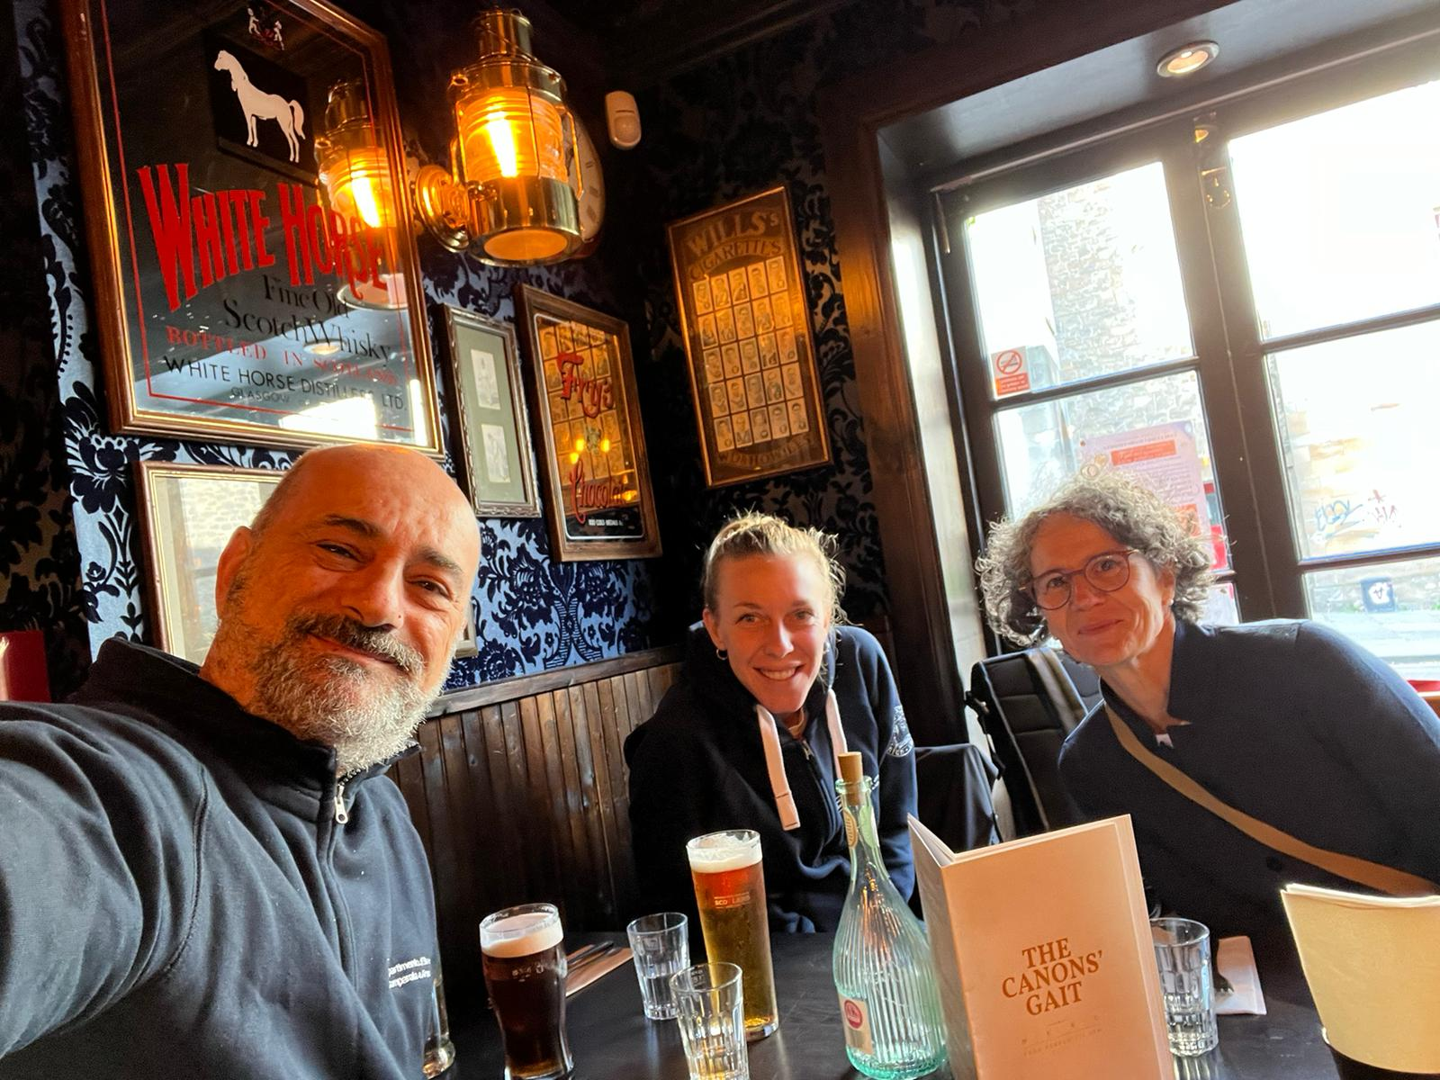
Thanks!!

Slide 3
Il riutilizzo di sedimenti dragati può rappresentare un pericolo per specie marine sessili?
Cambiamenti trascrizionali in seguito all’esposizione a sedimenti dragati in diverse aree
Definire il ruolo dei sedimenti nelle composizione del microbiota dell’ospite
Notes:
With this project we tried to define if the reuse of

Slide 4
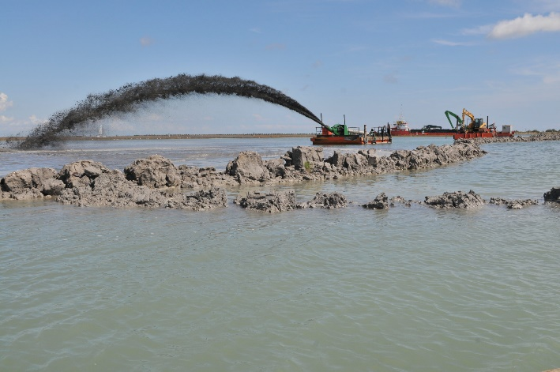
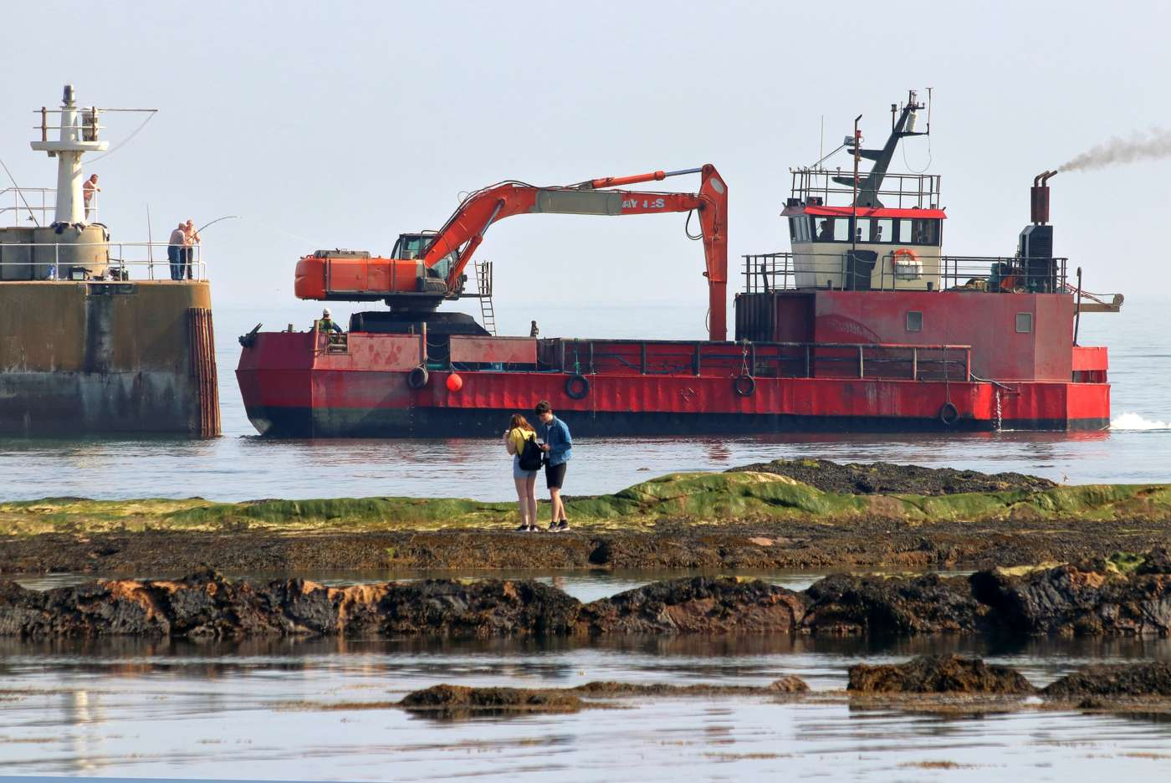
Perchè?
Il dragaggio e il riutilizzo dei sedimenti dragati rappresentano un'attività molto intensa nelle lagune fortemente antropizzate
Notes:
Dredging and reuse of dredged sediments is a very intense activity in highly anthropized lagoons and it can represent a potential source of stressors for populations inhabiting lagoon environments. The physical removal of the substrate
from the seabed and the resuspension and deposition of chemicals derived from industrial, agricultural and urban activities accumulated in sediments over decades
are known to increase turbidity and pollutant levels in the water column with potential impacts on benthic communities

Slide 5

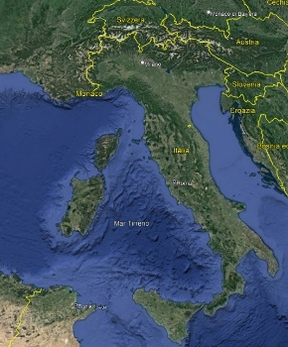
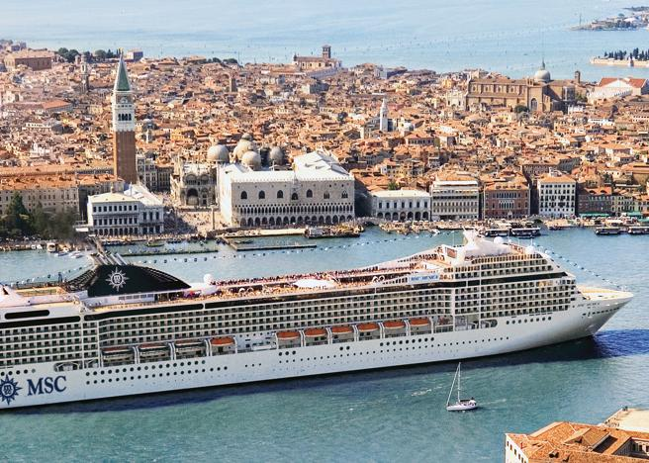
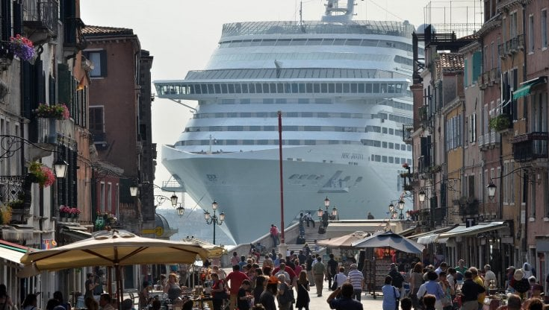
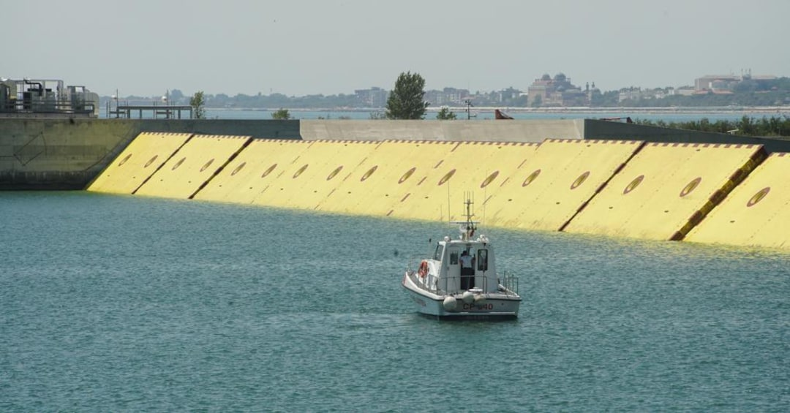
Dove?
Laguna di Venezia: dragaggio di circa 1 milione di m³/anno di sedimenti per permettere la navigazione
Notes:
the Venice lagoon is an emblematic case study as local authorities mobilize about 1 million m3/year of sediments (composed of sand, silt, and clay of both alluvial and marine origin) for navigation purposes.
Furthermore, the recent construction and maintenance of the MOSE system (Experimental Electromechanical Module) to protect Venice and its lagoon from flooding has significantly increased dredging activities at the three inlets of the Venice lagoon. On top of that, the Port Authority is planning to create and/or enlarge existent canals to allow the passage of large cruise ships

Slide 6
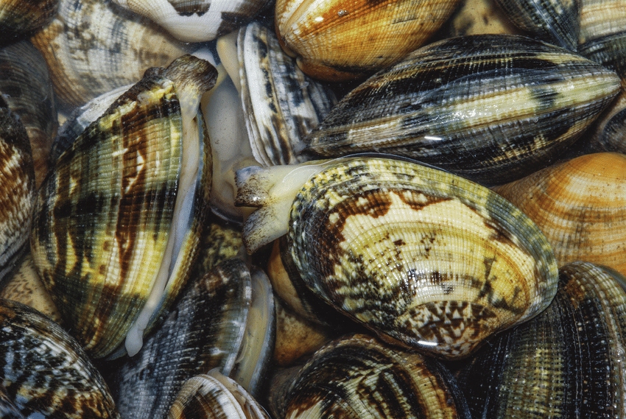
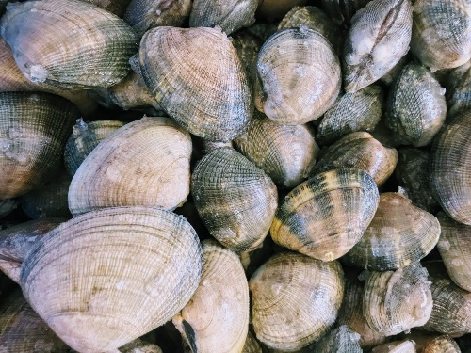

Specie
La vongola filippina Ruditapes philippinarum
Specie filtratrice di elevato interesse commerciale per la regione
ll cambiamento climatico e altri stress di origine antropica minacciano le popolazioni selvatiche e allevate
Produzione diminuita da 40,000 T nel 2000 a 3,000 T nel 2019
Notes:
The Manila clam Ruditapes philippinarum, a filterfeeding bivalve inhabiting sandy-mud bottoms, represents a species potentially affected by the reuse of contaminated sediments in the Venice lagoon. Native to the Indo-Pacific region, due to its high commercial value it was introduced for farming purposes in the
Mediterranean and Atlantic coasts in the early 70s [6]. Although the high adaptability and resistance to various stressors have allowed the Manila clam to spread rapidly in this area, overfishing, climate change and anthropogenic disturbances have been severely threatening wild and farmed populations. The lack of natural seed and increasingly frequent mortality events have significantly impacted natural populations and reduced the annual production in the Venice lagoon from 40,000 tons in 2000 to 3000 tons produced in 2019.
Climate change and anthropogenic disturbances are severely threatening wild and farmed populations.

Slide 7



Experimental plan - sampling
Campionamento dei sedimenti mediante carotatrice
(diametro del tubo : 8,55 cm; lunghezza: 1 m)
Campioni di sedimento estrusi dalle provette, accuratamente miscelati e utilizzati per un'esposizione controllata
CTL
Vittorio Emanuele III canal
Notes:
Sediment coring was performed by SELC Company at
the end of November 2020 in 5 sampling points placed
in the Vittorio Emanuele III canal fairway in the Venice
Lagoon (i.e. sediments I, II, III, IV and V) and one in
Canale San Felice (i.e. sediment VI), which represented
the control group
Site I was the closest to the city
of Venice, whereas site V was the closest to the industrial
area of Porto Marghera hosting a large commercial
port, thermo-electrical powerplants, and metallurgical
and chemical companies. Site VI (reference site) was in
the Canale San Felice characterized by low anthropogenic
influence and classified as a high-quality site due
to the fast turnover of the water [98, 99].

Slide 8

Piano sperimentale – esposizioni ed analisi
Tanks: 5 cm sediment layer. 50 clams (35.1 ± 3.3 mm length)/tanks 40 L
Seawater renewed every 48h
Animals daily fed with microalgae (Isochrysis galbana)
T0: prima dell’esposizione
Bioaccumulo animali e caratterizzazione sedimento (metals, PAHs, PCBs, PCDD/Fs, TBT, HCB, hydrocarbons)
Caratterizzazione del microbiota del sedimento (16S Amplicon Seq )
Trascrittomica (RNA-seq) e caratterizzazione microbiota ghiandola digestiva (10 individuals)
T1: day 3
Trascrittomica (RNA-seq) e caratterizzazione microbiota ghiandola digestiva
T2: day 14
Bioaccumulo animali (metals, PAHs, PCBs, PCDD/Fs, TBT, HCB, hydrocarbons)
Trascrittomica (RNA-seq) e caratterizzazione microbiota ghiandola digestiva
Notes:
Tanks prepared with a sediment layer (5 cm height to guarantee the clams burrowing) and 40 L of clean seawater
Clams collected in farming site in the South of the Venice Lagoon and acclimated in controlled conditions for 1 week.
Every 48 h, the seawater in the experimental tanks was
changed by renewing 15 L of water.
Clams (35.1 ± 3.3 mm mean length) were collected in a
farming site in the South of the Venice Lagoon and acclimated
in controlled conditions for 1 week.

Slide 9
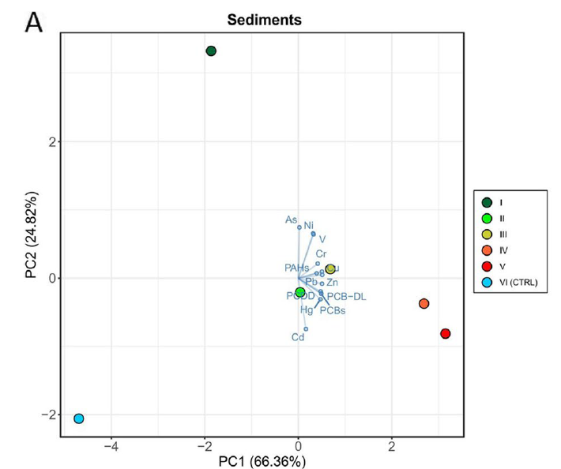


Risultati – caratterizzazione chimica dei sedimenti
PCDD/Fs, PCBs, metalli (Cd, Hg, Pb, Zn, Cu) aumentano dal sito I al sito V confermando la loro origine industriale
PCDD/Fs and PCBs: 72 -120 volte più alte nel sito IV e V rispetto al CTL (VI)
PAHs (tutti i siti): da 63 a 148 volte più alta del CTL (VI)
CTL
Notes:
HC: hydrocarbonsThe sediment of the control site (VI) was mainly composed of sand (90.1%), while the silt component was predominant
(> 59%) in sites I to V.
Sediments from different sites were clearly separated along the x-axis (66.36%) perfectly resembling the geographical sampling location within the canal as well as demonstrating the clear separation of the control site.
Metal concentrations measured in the sediments on day14 (end of clam exposure; Table S2B) did not show significant changes compared to T0.

Slide 10
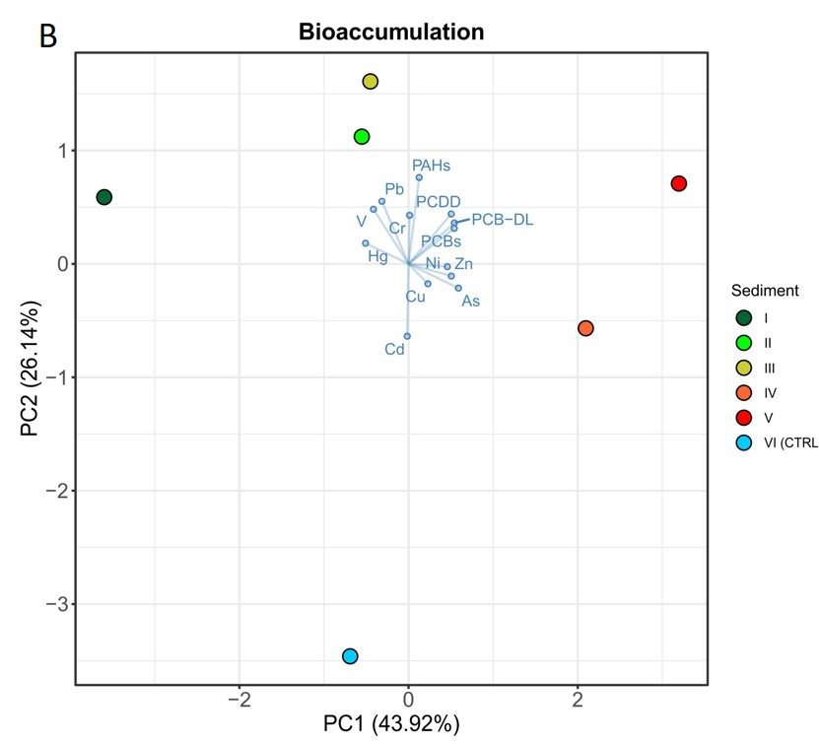
Risultati - bioaccumulo
Metalli
Bioaccumulo limitato
PCBs, PCDD/Fs and PCB-DL
bioaccumulo importante con concentrazioni
sempre più elevate da sito I a sito V
PAHs
bioaccumulo simile in tutti i siti
CTL

Slide 11
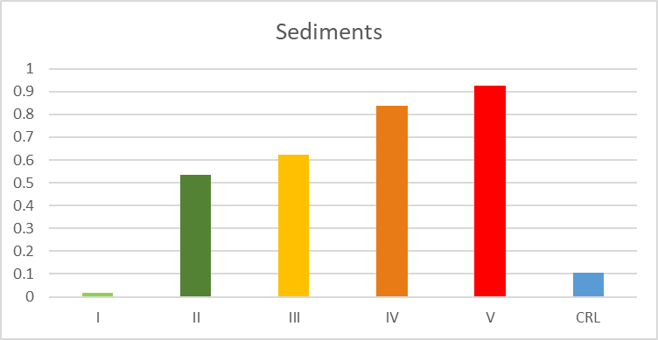
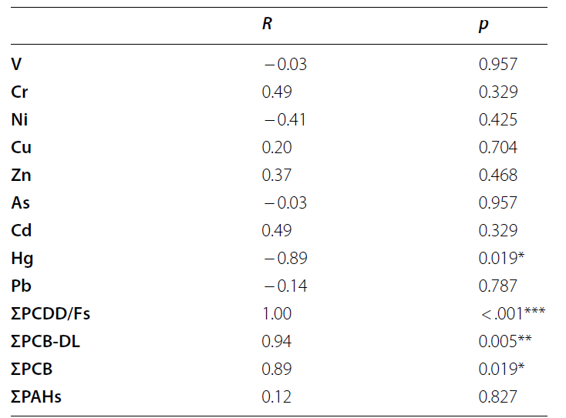
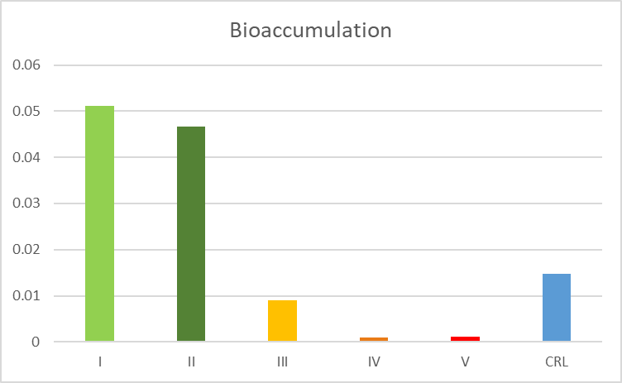
Risultati analisi chimiche
mg/kg dw;
Spearman’s correlation coefficients between sediments concentrations and bioaccumulation
µg/kg
Bioaccumulo non sempre consistente con le concentrazioni di metalli trovate nel sedimento
Notes:
A significant positive correlation was observed for PCDD/Fs, PCBs and PCB-DL. Conversely, a significant negative correlation was observed for Hg.
In detail, although the Hg concentration in sediments collected from industrial. sites (IV and V) was more than 45 times higher than in site I, bioaccumulation showed an opposite trend, with Hg bioaccumulation in clams exposed to sediments from sites IV and V being 82 and 43 times lower, respectively, than in T0 clams (collected from a clean farming site) and in site I clams.
The case of Hg is emblematic, showing a significant negative correlation between sediments and bioaccumulation. These results indicate that bioaccumulation is not always consistent with metal concentrations detected in sediments, confirming the difficulty of relating metal bioaccumulation to environmental concentrations [16] as already highlighted in clams inhabiting heavily contaminated Venice lagoon sites .

Slide 12
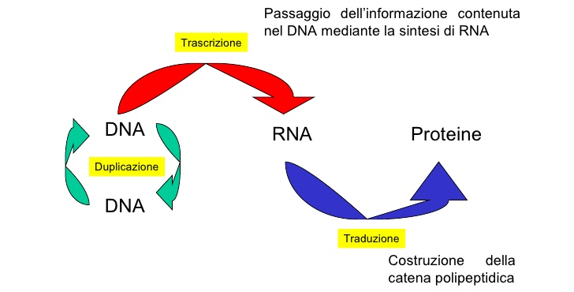
Trascrittomica
Studio dell'insieme completo degli RNA messaggeri (trascritti) prodotti dalle cellule.
Fornisce informazioni su quali geni sono attivi e come variano nelle diverse condizioni.
Aiuta a comprendere le risposte cellulari a diversi «fattori», tra cui gli stress ambientali
Possibile regolazione in risposta a condizioni ambientali

Slide 13
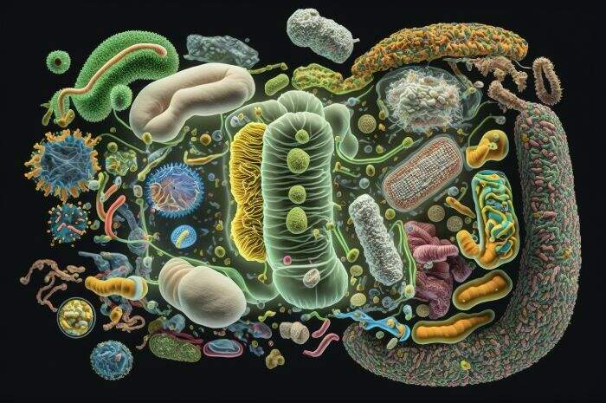
Microbiota
Insieme di microrganismi, come batteri, virus e funghi, che vivono nel nostro corpo, e svolgono funzioni cruciali per la digestione, l'immunità e la salute generale.

Slide 14


Risultati - trascrittomica
N° di geni differenzialmente espressi
L’attivazione di specifiche pathway molecolari nelle prime fasi di esposizione mitiga l’impatto dei contaminanti
35.6% di geni significativi comune
Notes:
Significant positive correlation between sediment contamination and gene expression profiling on day 3 suggests that the level and type of contaminants in the sediments are the main drivers of gene expression changes and that these changes occur linearly as the chemical contamination increases.
Pearson’s correlation between the coordinates along the first components of variation of the sediment’s PCA (Fig. 1A) and of the gene expression’s PCA after 3 and 14 days of exposure (Fig. 2). A significant correlation was found after 3 days of exposure (R = 0.94; p = 0.016)
while no significant correlation was found after 14 days of treatment (Additional file 1: Fig. S1).
The upregulation of this pathway was particularly evident in clams exposed to sediments collected at sites IV and V, with a total of 7 and 8 upregulated genes coding for ATP-binding cassette transporters, respectively. ABC transporters are a family of proteins that play a key role in cellular detoxification, facilitating the transport of various substances out of cells. Several studies showed that the ABC protein family can be involved in the excretion of metal ions.
The upregulation of this pathway was particularly evident in clams exposed to sediments collected at sites IV and V, with a total of 7 and 8 upregulated genes coding for ATP-binding cassette transporters, respectively. ABC transporters are a family of proteins that play a key role in cellular detoxification, facilitating the transport of various substances out of cells. Several studies showed that the ABC protein family can be involved in the excretion of metal ions

Slide 15
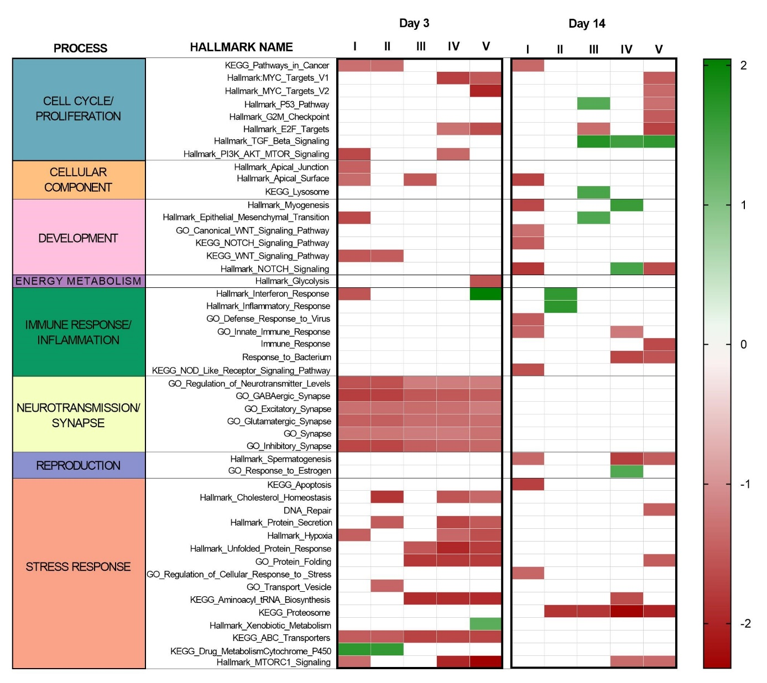
Risultati – trascrittomica
pathway molecolari
Cambiamenti significativi a inizio esposizione (day 3)
Più important modificazioni nei siti I,
IV and V

Slide 16
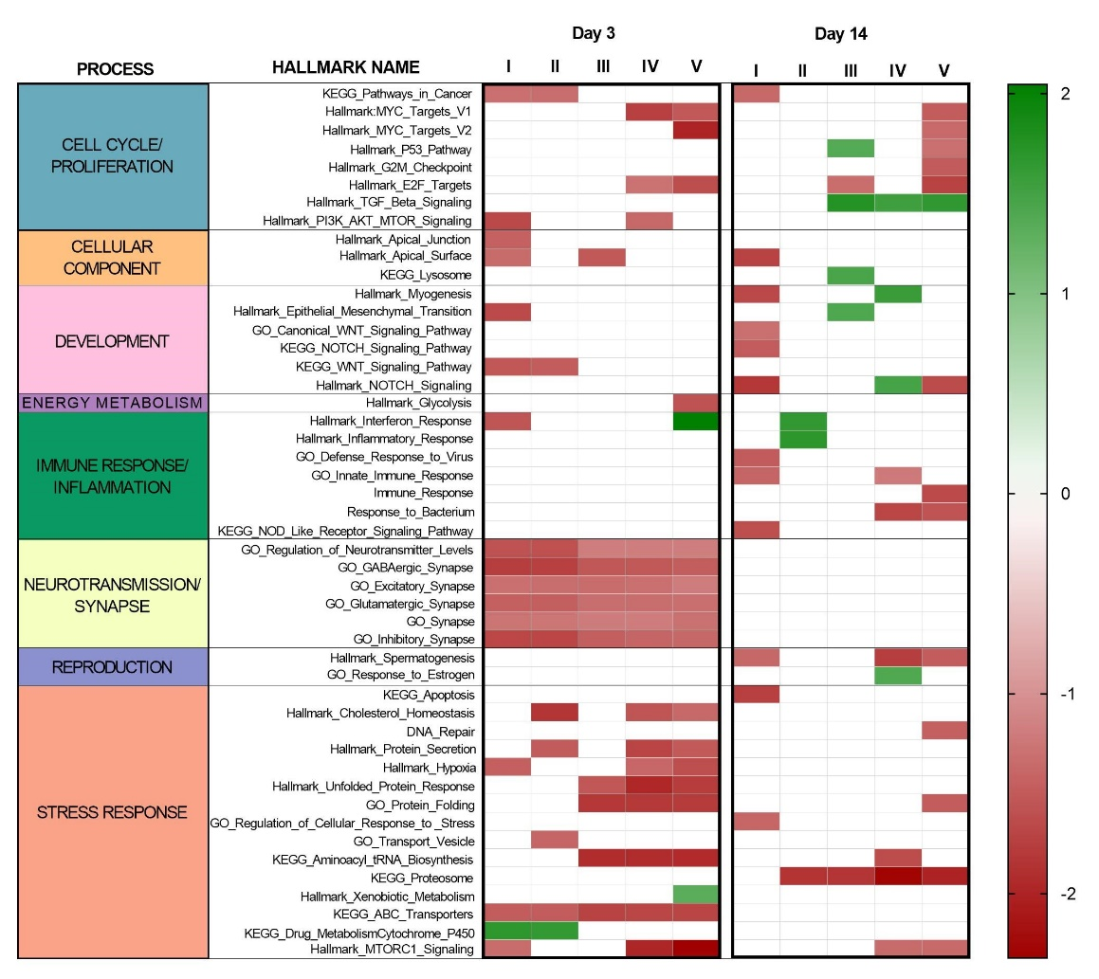

Risultati trascrittomica
ABC transporters e Acquaporine: importanti in detossificazione dai metalli
Notes:
clams may activate molecular mechanisms capable of significantly reduce metal bioaccumulation.
The ABC transporter pathway, upregulated on day 3 in clams exposed to sediments collected in the canal Vittorio
Emanuele III, may play a key role in the response to metal contamination. The upregulation of this pathway
was particularly evident in clams exposed to sediments collected at sites IV and V, with a total of 7 and 8 upregulated
genes coding for ATP-binding cassette transporters, respectively. ABC transporters are a family of proteins
that play a key role in cellular detoxification, facilitating the transport of various substances out of cells. Several studies showed that the ABC protein family can be involved in the excretion of metal ions [18–21].

Slide 17

Risultati trascrittomica
Sito IV e V
mTORC1 signalling pathway
Protein secretion
Unfolded protein responses
Protein folding
Aminoacyl tRNA biosynthesis proteasome
Cell cycle- and apoptosis related gene
Vesicle and protein trafficking
Glygolysis
….
Notes:
In general, mTORC1 signalling plays a central role in eukaryotic cells and organismal physiology by coordinating cell growth and metabolism with environmental conditions. Environmental stressors can have complex effects on mTORC1. mTOR signalling
functions in bivalve species is still limited and much remains to be explored to decipher its role in stress
Although the role of mTORC1 in apoptosis regulation is not universally inhibitory, recent studies have suggested that, among its downstream signalling pathways, mTORC1 can activate pro-survival signals that protect cells from apoptosis
Molecular pathways, such as vesicle and protein trafficking, glycolysis and cell cycle regulation, The upregulation of several genes involved in endosome
and vesicle trafficking may be closely related to increased protein secretion and protein turnover. Recent evidence indicates that mTORC1 directly controls Golgi
architecture, endosome and lysosome distribution, and extracellular vesicle secretion [

Slide 18

«Interazioni ospite-microbiota»
Site I, IV and V
Attivazione risposta immunitaria potenzialmente dovuta ad un aumento di Arcobacter e Tenacibalum (patogeni opportunisti)
Notes:
from the city of Venice, which in some places lacks adequate
wastewater treatment facilities, can lead to relevant
concentrations of several contaminants such as
fragrancesagricultural products (e.g. glyphosate),
drugs (e.g. Diclofenac), antibiotics and PFAS [82]
among others, as recently highlighted in the monitoring
plan of the Venezia 2021 project ( [83]; unpublished
data). Further studies, including the quantification of
other contaminants, will help to decipher specific molecular
signatures associated with responses to chemicals of
urban and/or industrial origin.
Arcobacter spp. are
considered opportunistic pathogens of several marine
species [88], and are often associated with unhealthy
marine animals
Tenacibaculum spp. is a gramnegative
and motile bacterial genus belonging to the
Flavobacteriaceae and includes opportunistic species
often associated with mortality events [92, 93].

Slide 19
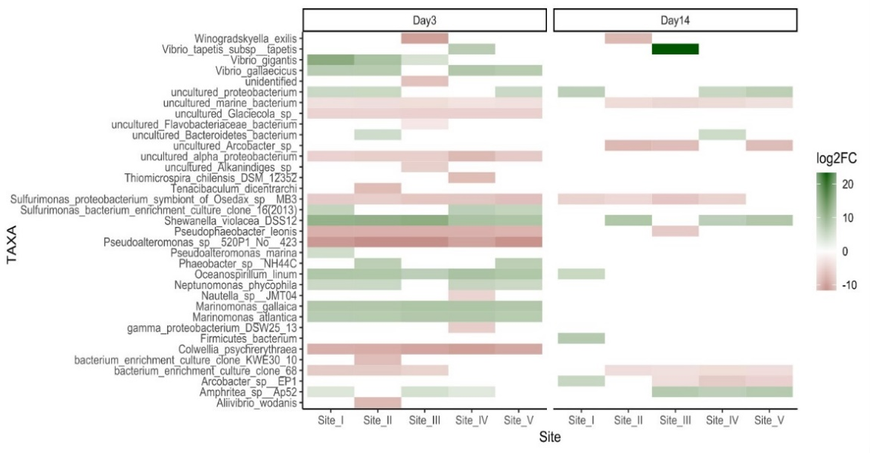
Risultati – microbiota sedimenti
e della ghiandola digestiva
Sedimenti: da 35 a 47 taxa significativi (sp.)
Day 3 (DG): da 16 a 21 taxa significativi (sp.)
Day 14 (DG): da 5 a 8 taxa significativi (sp.)
Numero simile di taxa significative tra i siti
70 - 82% di taxa significativi nei sedimenti non erano differenzialmente rappresentati nella ghiandola digestiva degli animali
Vongola filippina in grado di controllare il proprio microbiota
Notes:
While transcriptional
data showed major changes in clams exposed to sediments from sites IV and V, similar number of differentially represented microbial taxa identified among sites

Slide 20
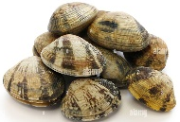
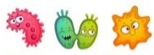

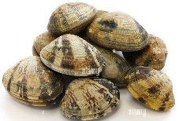
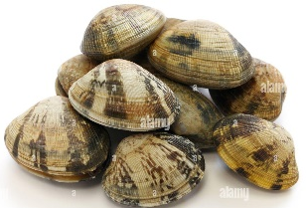

Come i sedimenti influenzano il microbiota della ghiandola digestiva
Microbiota ghiandola digestiva
T0 vs day 3 + day 14 (per ogni sito): 37 taxa significativi
Gruppo I
Taxa acquisiti durante esposizione (non presenti in GD al T0)
Group II
taxa “aumentati” durante esposizione, non presenti in sedimenti
T0
T0
Day 3 + Day14
Day 3 + Day14
27 taxa: Proteobacteria, Espilonbacteraeota, Firmicutes and Bacteroidetes
10 taxa: Proteobacteria
Notes:
taxa acquired from the sediments during exposure (not present in clams at T0)
Group II taxa overrepresented following exposure not represented in the corresponding sediment

Slide 21

Come i sedimenti influenzano il microbiota della ghiandola digestiva
27 dei 37 taxa (> 73%) aumentati in ghiandola digestiva durante esposizione probabilmente acquisiti dal sedimento

Slide 22
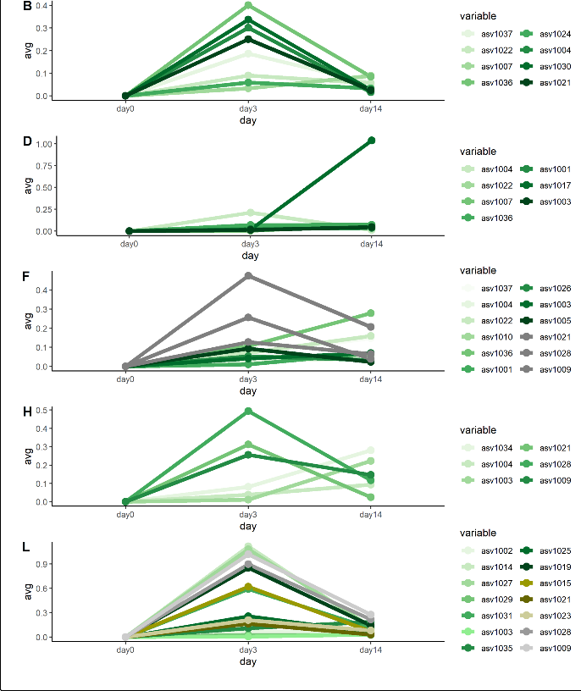
I
Group I
Taxa acquisiti dal sedimento
Aumento significativo al giorno 3, diminuzione al giorno 14
II
Day 0
Day 3
Day 14
III
Animali controllano la diffusione di specie microbiche acquisite dal sedimento
IV
Day 0
Day 3
Day 14
V
Day 0
Day 3
Day 14
Notes:
it is a second clue that clams are able to control the microbiota

Slide 23
Take home messages
Trascrittomica
mTORC1 signalling pathway: ruolo chiave nella regolazione e coordinamento di importanti pathway molecolari
ABC transporters +AQP: detossificazione da metalli, con conseguente bioaccumulo di metalli non correlato a concentrazioni rilevate nei sedimenti.

Slide 24
Take home messages
Microbiota dei sedimenti e della ghiandola digestiva
Capacità delle vongole di controllare la composizione delle comunità microbiche della ghiandola digestiva (acquisizione limitata di specie microbiche dai sedimenti)
Tuttavia, il microbiota dei sedimenti svolge un ruolo importante nel modellare (transitoriamente) il microbiota delle vongole
La proliferazione di agenti patogeni opportunisti può rappresentare un'ulteriore minaccia per le vongole esposte a stress chimico

Slide 25

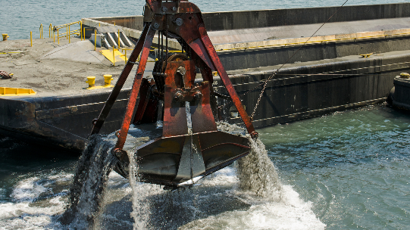
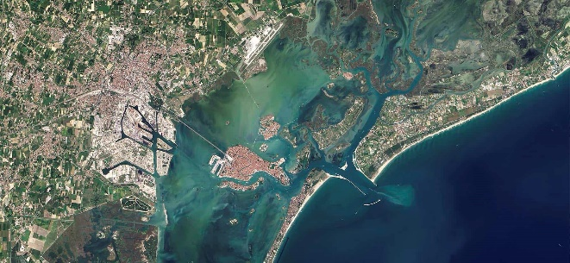
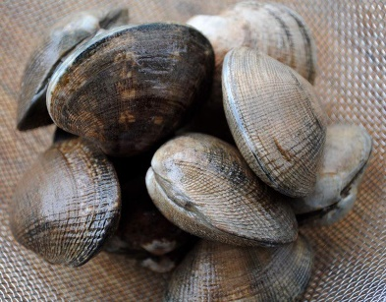
Take home messages
Il riutilizzo di sedimenti dragati può rappresentare un rischio per le specie marine sessili?
I cambiamenti trascrizionali e microbici più importanti si verificano nella fase iniziale dell’esposizione.
Tuttavia, occorre prestare cautela nel riutilizzo dei sedimenti dragati in aree fortemente antropizzate (es. Laguna di Venezia), in particolare per una specie soggetta a molteplici fattori di stress (agenti patogeni, ondate di caldo) che sta già sperimentando una drastica riduzione delle sue popolazioni naturali e allevate

Slide 26
Thank you …… and
follow us…

Slide 30

Results –transcriptomics
Site I
Signalling and development
Pathways in cancer
Apoptosis (day 14)
Response to stress (Day 14)
Hypoxia (Day 3)
All sites
Neurotransmission and
synapse (Day 3)
Transcriptional changes due to contaminants released from Venice city

Slide 31
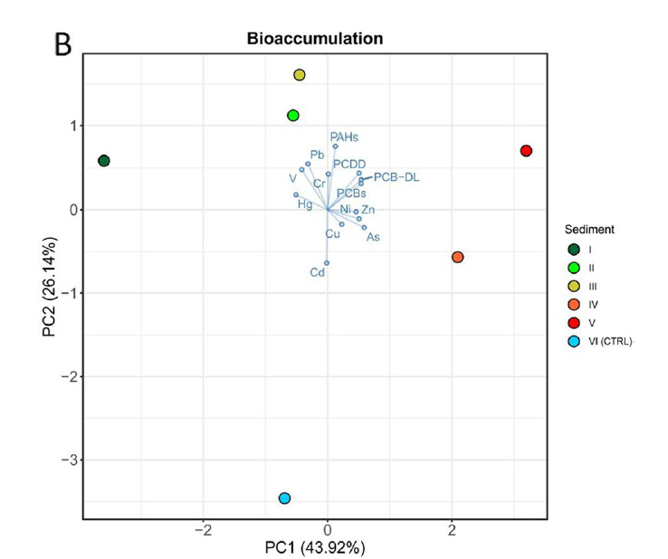

Slide 32
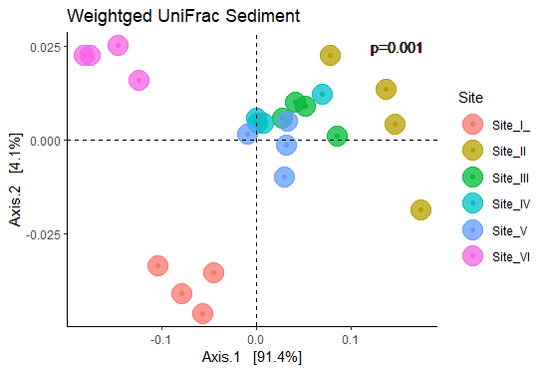
Microbiota - PCoA
Sediments
Clams
Day 3: No separation among sites

Slide 33
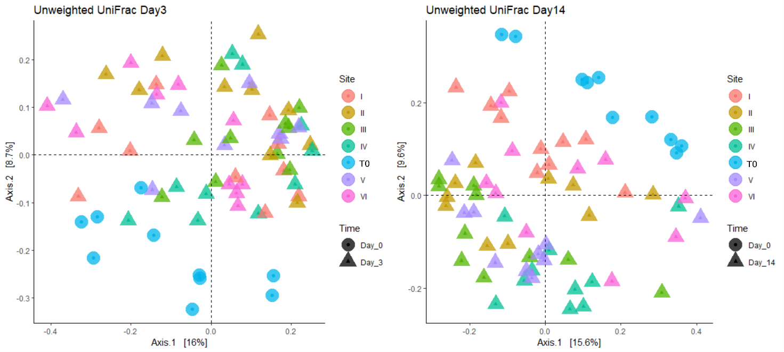
Microbiota - PCoA
Sediments
Clams
Day 14: Similar to PCA

Slide 34
Microbiota - alpha diversity metrics
Slight increase in richness of DG microbiota from T0 to day 14 (p-value = 0.06)
No significant differences between sites

Slide 35
Results –transcriptomics
Site IV and V
mTORC1 signalling pathway
Pivotal role in stress responses
Notes:
In our experiment, the upregulation of the mTORC1
signalling pathway and several transcriptional changes
in its downstream pathways following the exposure to
the most polluted sediments suggested that this pathway
may play a pivotal role in the response to chemical
stress.

Slide 36
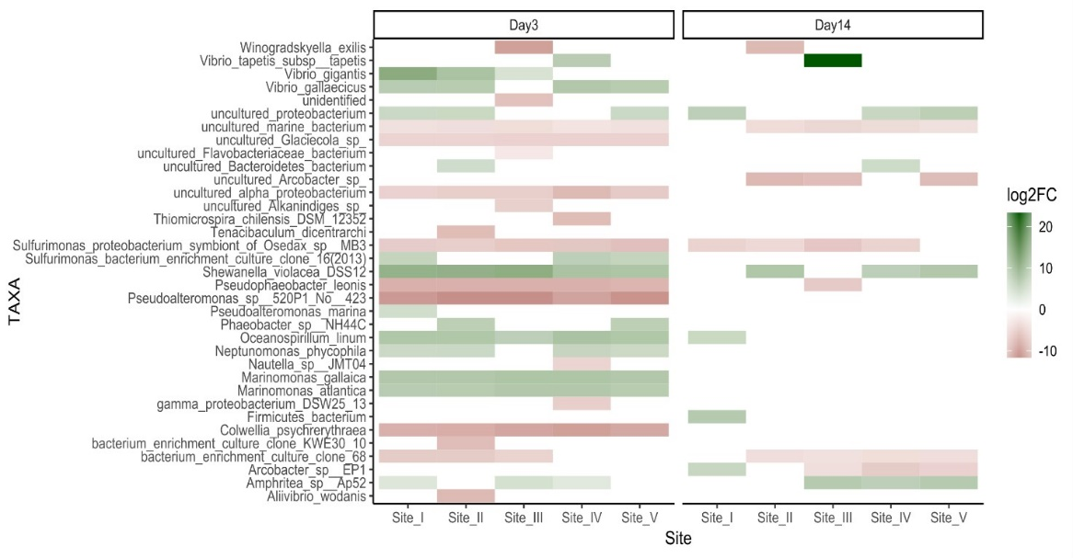
Microbiota – pairwise comparisons
Sediments: Arcobacter higher in CTL site
Day 3: Tenacibaculum in clams DG site II
Day 14: Arcobacter in sites III, IV and V
Tenacibaculum in site I and V

Slide 37
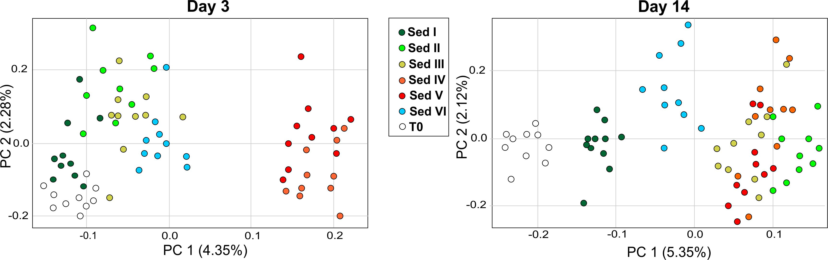


Results – transcriptomics
CTL
T0

Slide 38

Results –transcriptomics
CTL
T0

