Slide 1


Slide 2

PTP 0007 ACCREDIA
The interlaboratory circuit is organized in agreement with international guidelines relative to the organization and management of interlaboratory circuits UNI CEI EN ISO/IEC 17043: 2010
Statistical data treatment in InterCinD is INSPIRED by ISO 13528/2015 and IUPAC Guidelines
Peculiarities of INTERCIND
Natural matrixes (unknown concentration)
Replicates (accuracy&precision)
Statistical treatment (Determination of extremes/blunders with non-parametric method)

Slide 3
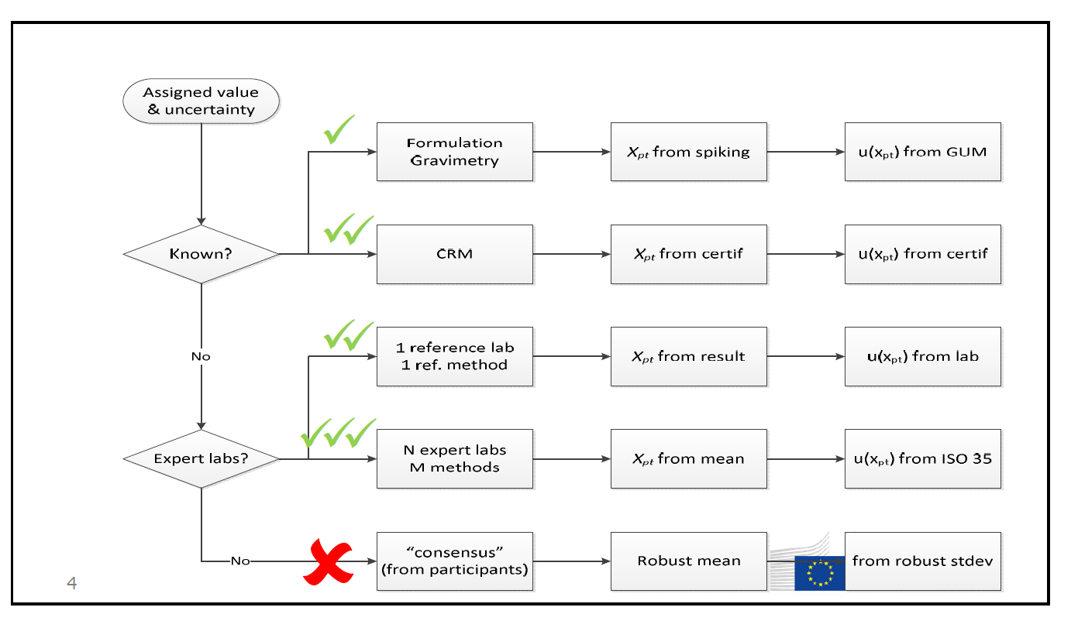
Determination of assigned value
from: Piotr Robouch (JRC) - 9th International Workshop on Proficiency Testing (9-12 October 2017, Portoroz, Slovenia)

Slide 4
InterCinD procedure
Use σp
Homogeneity and stability
Ss<= 0.3 σp

Slide 5
InterCinD procedure
Data from Labs
Use σp
InterCinD input form
Form not filled in properly?
Homogeneity and stability
First check
Ss<= 0.3 σp

Slide 6
InterCinD procedure
Data from Labs
Use σp
InterCinD input form
Homogeneity and stability
Form not filled in properly?
First check
Ss<= 0.3 σp
Data are extremes?
Data
removed
Valid data
Statistical analysis of the treated dataset

Slide 7
InterCinD procedure
Data from Labs
Use σp
InterCinD input form
Homogeneity and stability
Form not filled in properly?
First check
Ss<= 0.3 σp
Data are extremes?
Data
removed
Assigned value and σpt = 30% a priori
Statistical evaluation is performed on the dataset reporting the averaged value of the three replicates for every chemical species/index and lab
Valid data
Statistical analysis of the treated dataset
TEST1
TEST1b
TEST1b
TEST2
TEST3
Nlab>=12
RSD%<55%
extremes <20%
Simmetry of data?
MEAN or MEDIAN
U < 0.3 σpt
TEST2b
no
no
No assigned value
Kernel plot
No assigned value
If yes, use median (robust statistics)

Slide 8
InterCinD procedure
Use σp
The final step is the EVALUATION OF PERFORMANCE on the entire dataset including replicates
Precision (r-range)
Accuracy (z-score)
Data from Labs
Homogeneity and stability
InterCinD input form
Form not filled in properly?
First check
Ss<= 0.3 σp
Data are extremes?
Data
removed
Assigned value and σpt = 30% a priori
Statistical evaluation is performed on the dataset reporting the averaged value of the three replicates for every chemical species/index and lab
Valid data
Statistical analysis of the treated dataset
TEST1
TEST1b
TEST1b
TEST2
TEST3
Nlab>=12
RSD%<55%
extremes <20%
Simmetry of data?
MEAN or MEDIAN
U < 0.3 σpt
TEST2b
no
no
No assigned value
Kernel plot
No assigned value
If yes, use median (robust statistics)

Slide 9
InterCinD procedure: last improvements
Treated dataset without extremes but including outliers;
Sigma pt = 30% of consensus value based on previous PTs;
RSD < 55% never > 100%;
Stability and homogeneity check;
Sigma pt = 30% of consensus value based on previous PTs.

Slide 10
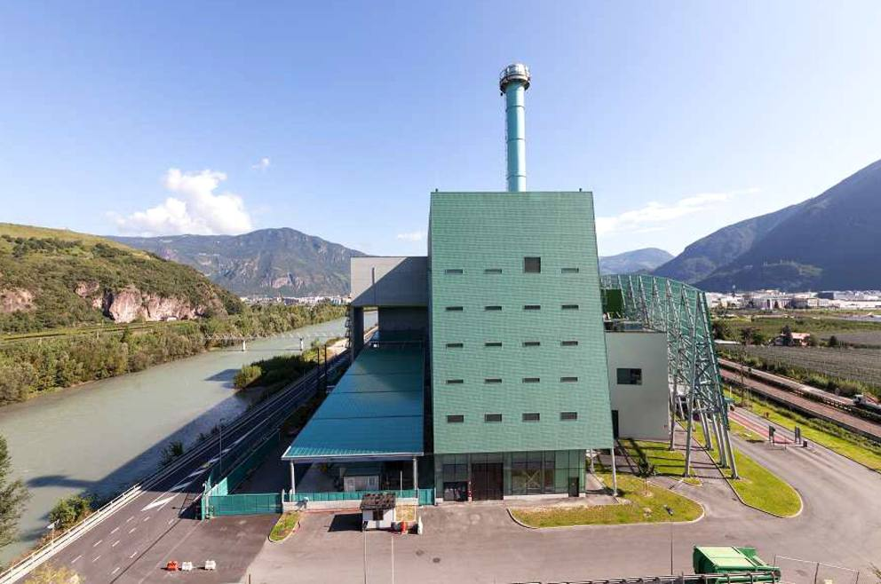
Termovalorizzatore di Bolzano

Slide 11
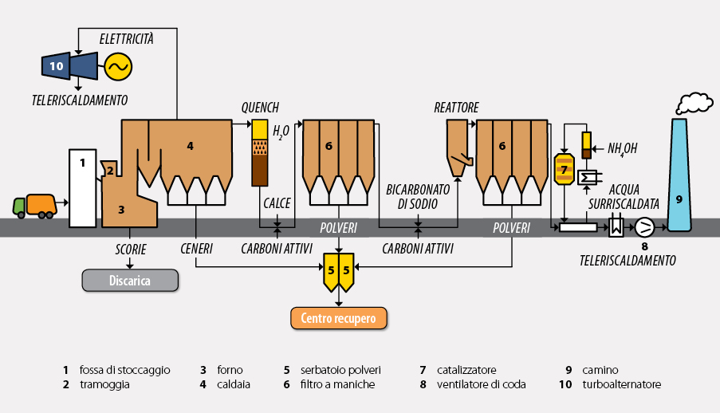

Slide 12
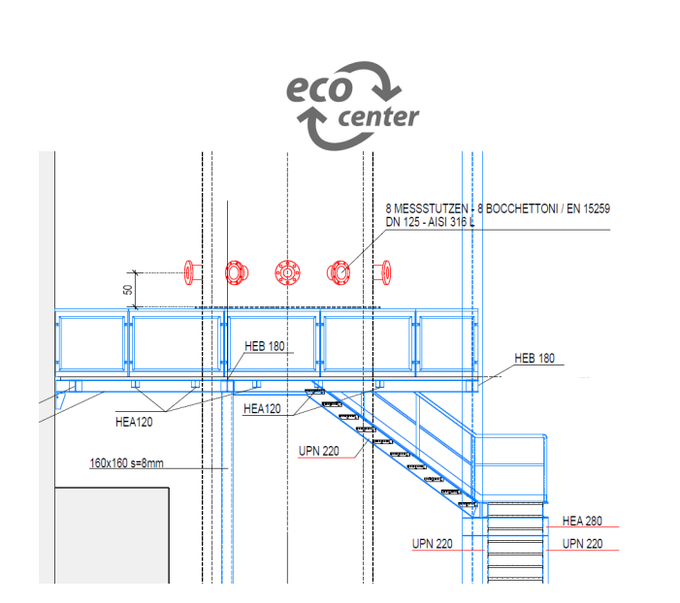

Slide 13
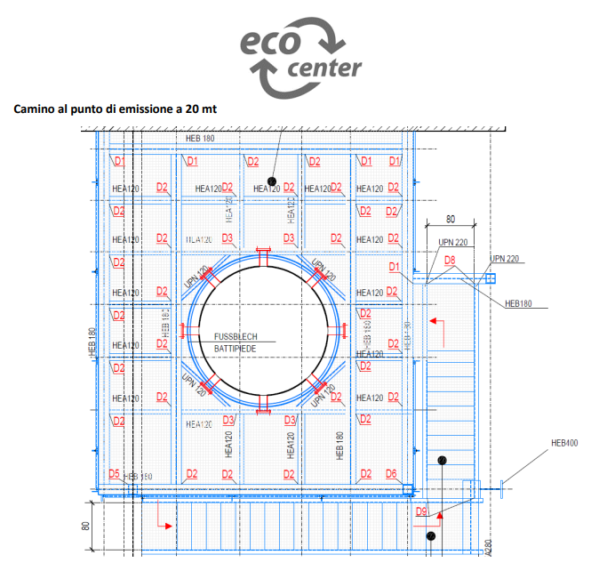

Slide 14
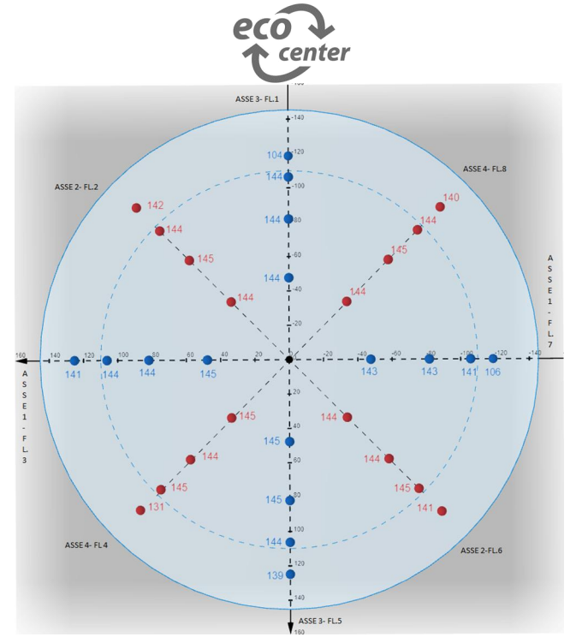
Test di omogeneità come da norma UNI EN15259:2008 in condizioni di lavoro normale dell’impianto
Verifiche effettuate sul punto di emissione a 20 m
Monitorati 32 punti distribuiti su quattro assi, utilizzando 8 bocchelli
I parametri verificati sono CO, NOx, O2, CO2, temperatura e velocità
Il flusso è risultato omogeneo per gli scopi del progetto

Slide 15
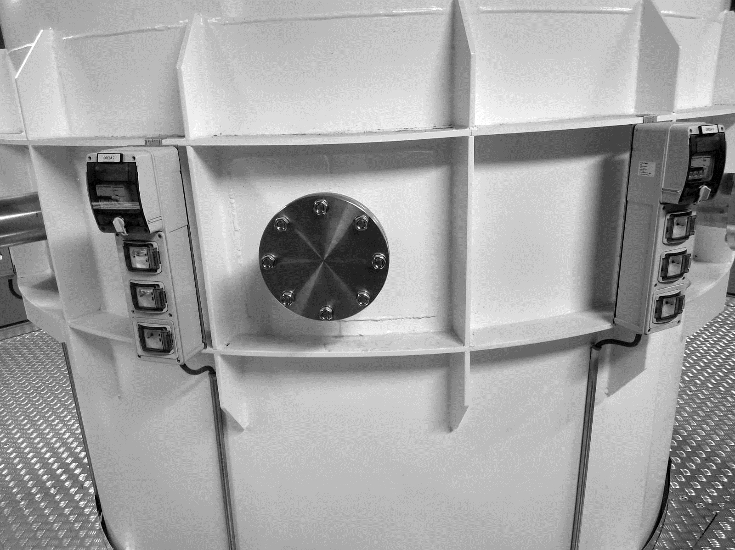

Slide 16
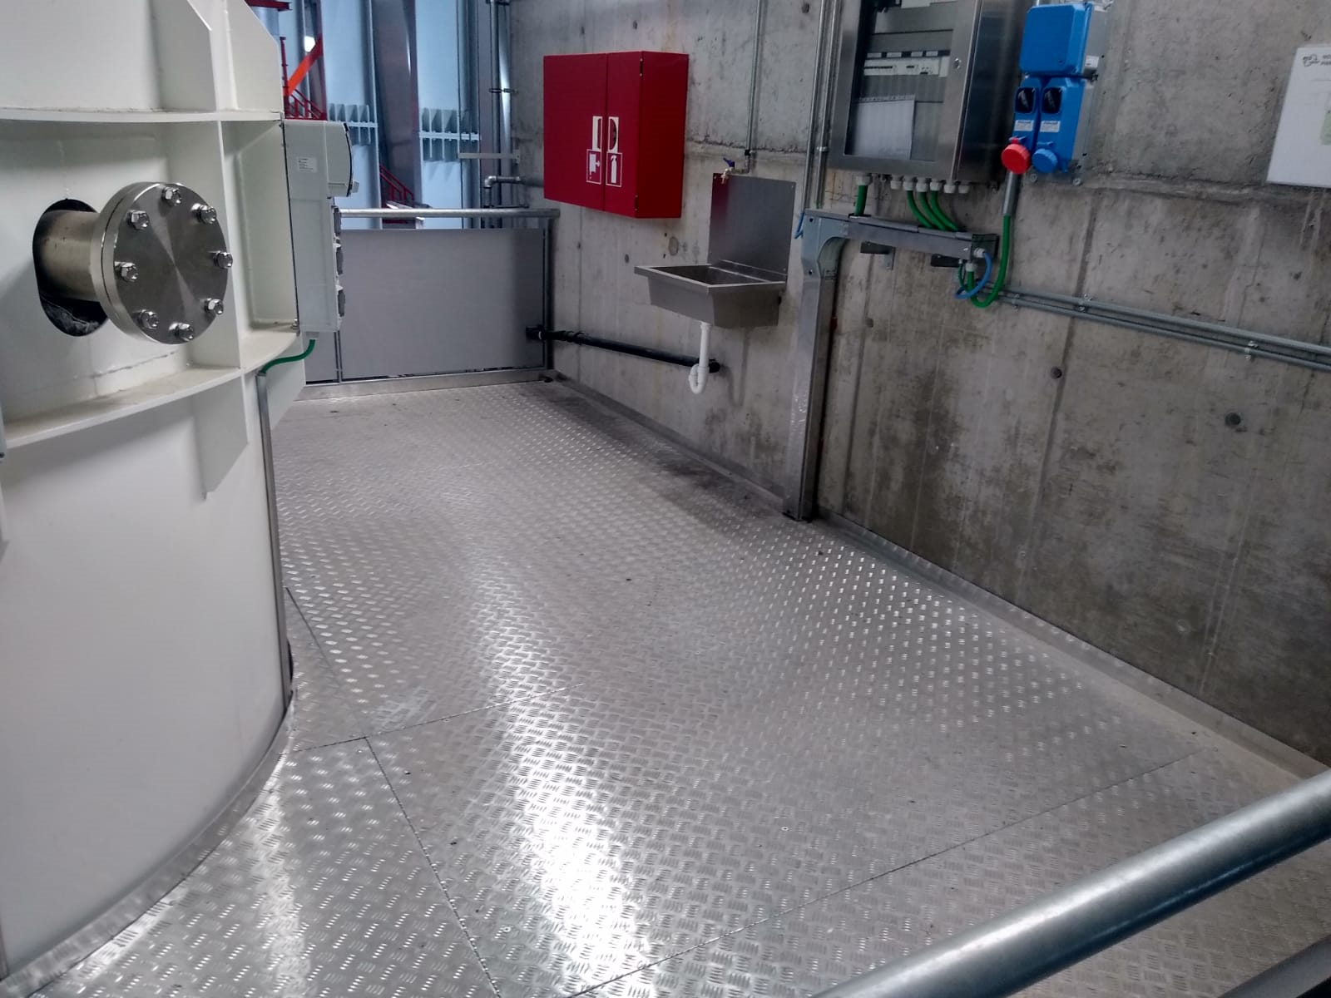

Slide 17
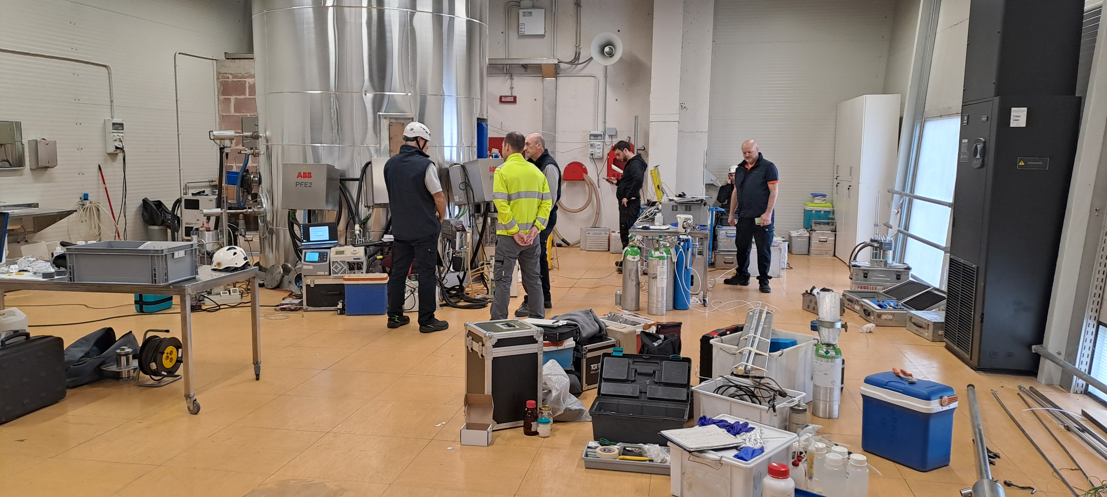

Slide 18
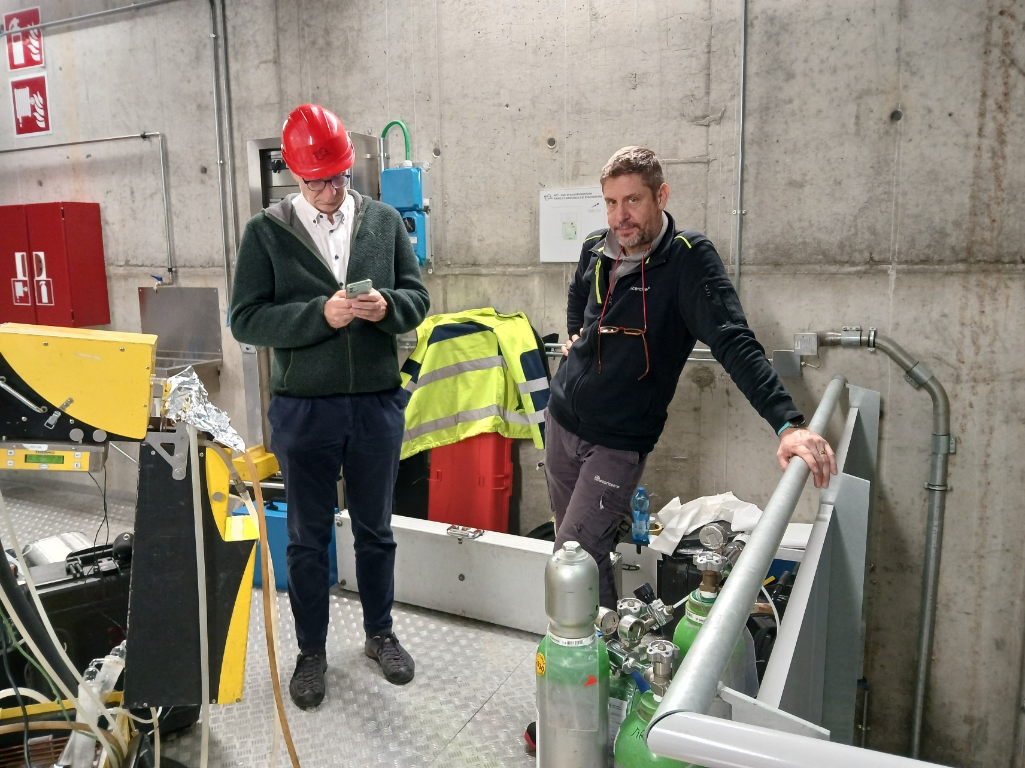
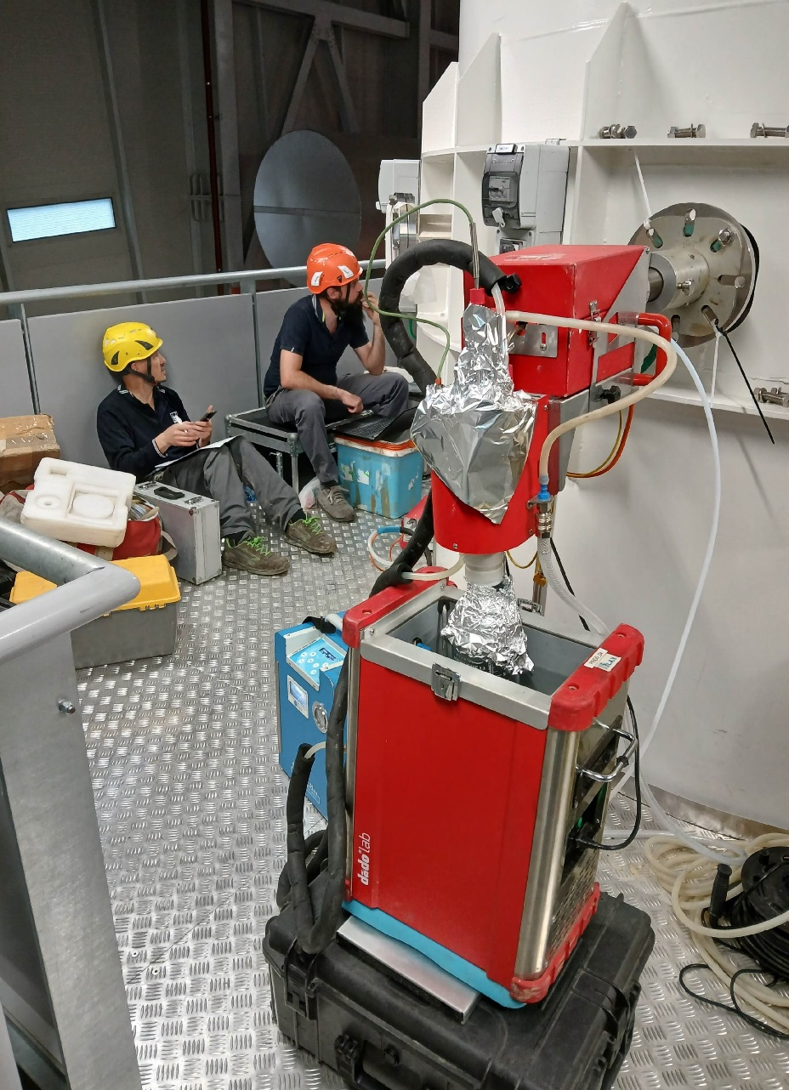
Misurandi
PCDD/F
PCB
Umidià
CO, NOx, O2, CO2

Slide 19
Partecipanti
 | Altezza camino | Punto di prelievo | Laboratorio
1 | Sala SME 30m | Flangia 3 Punto a 0,71 m | APPA BZ
 | Sala SME 30m | Flangia 3 Punto a 0,71 m | APPA BZ
2 | Sala SME 30m | Flangia 2 Punto a 0,71 m | ARPA VENETO | Dip. Belluno
 | Sala SME 30m | Flangia 2 Punto a 0,71 m | ARPA VENETO | Dip. Belluno
 | Sala SME 30m | Flangia 2 Punto a 0,71 m | ARPA VENETO | Dip. Treviso
 | Sala SME 30m | Flangia 2 Punto a 0,71 m | ARPA VENETO | Dip. Venezia
3 | Punto camp. 20m | Flangia 7 Punto a 0,43 m | ECORICERCHE
4 | Punto camp. 20m | Flangia 6 Punto a 0,43 m | L.A.V WHITE LAB
 | Punto camp. 20m | Flangia 6 Punto a 0,43 m | L.A.V WHITE LAB
5 | Punto camp. 20m | Flangia 1 Punto a 0,71 m | CSA
 | Punto camp. 20m | Flangia 1 Punto a 0,71 m | CSA
6 | Sala SME 30m | Flangia 1 Punto a 0,71 m | ECO-CENTER
 | Sala SME 30m | Flangia 1 Punto a 0,71 m | ECO-CENTER

Slide 20
Preliminary results

Slide 21

Vi aspettiamo a Riva del Garda -Trento

Slide 22
Grazie e buon appetito!

