Slide 1


Bologna POP’s day, 07 Giugno 2024
I PFAS nell’ambiente marino mediterraneo:
spunti di tossicologia ambientale e alimentare
Dott. Gianfranco Brambilla - Istituto Superiore di Sanità, Dipartimento di Sicurezza Alimentare, Nutrizione e Sanità Pubblica Veterinaria, Rome, Italy
gianfranco.brambilla@iss.it

Slide 2

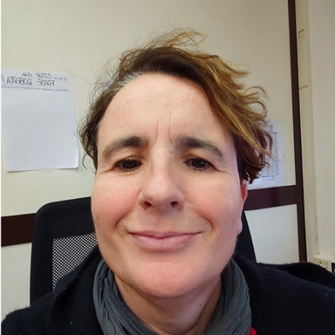

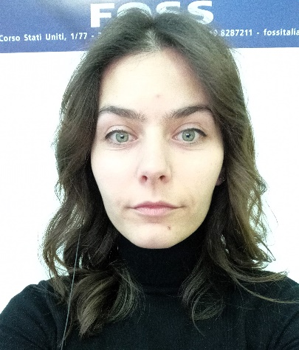
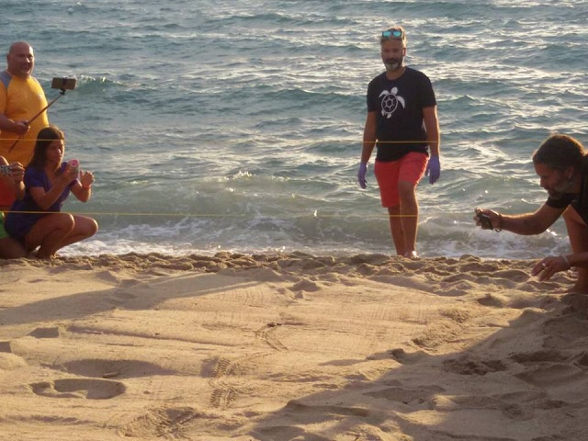




Ringraziamenti
Roberta Galarini, Simone Moretti, Carolina Barola
Fulvio Maffucci
Roberto Miniero
Mauro Esposito
Italian Ministry of Health, project TurtHea IZSME RC 07/2022 and IZSUM RC 06/2020 Grants

Slide 3
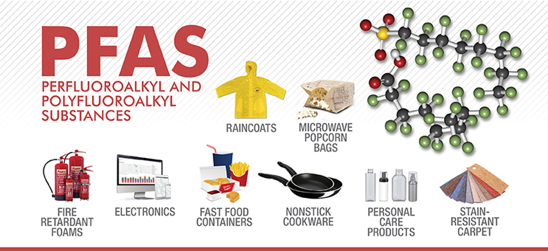

Slide 4

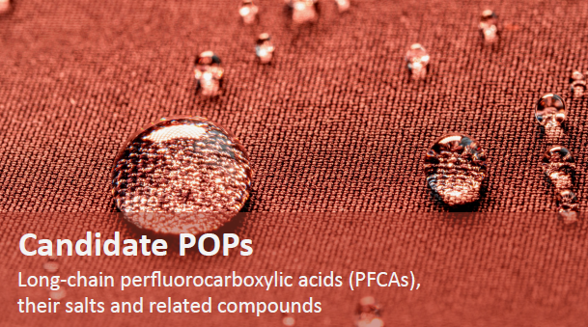
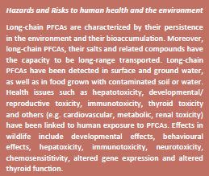

https://chm.pops.int/Implementation/PFOS/Overview/tabid/5221/

Slide 5
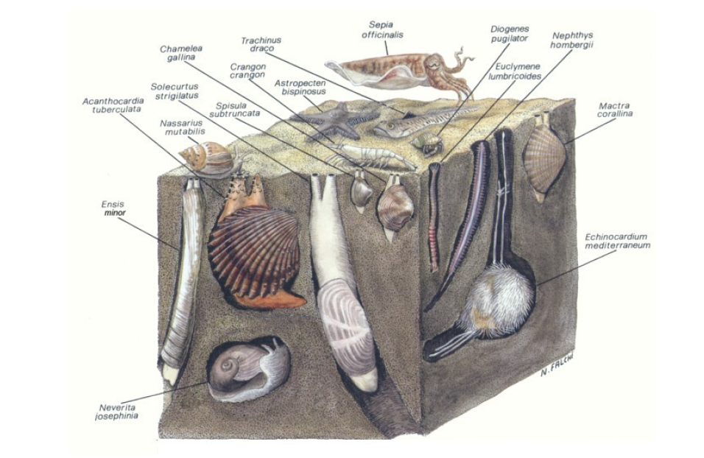
Specie demersali e bentoniche

Slide 6
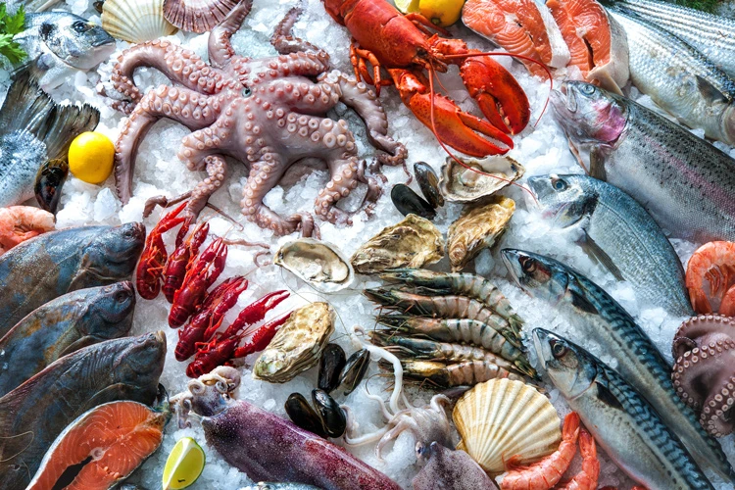
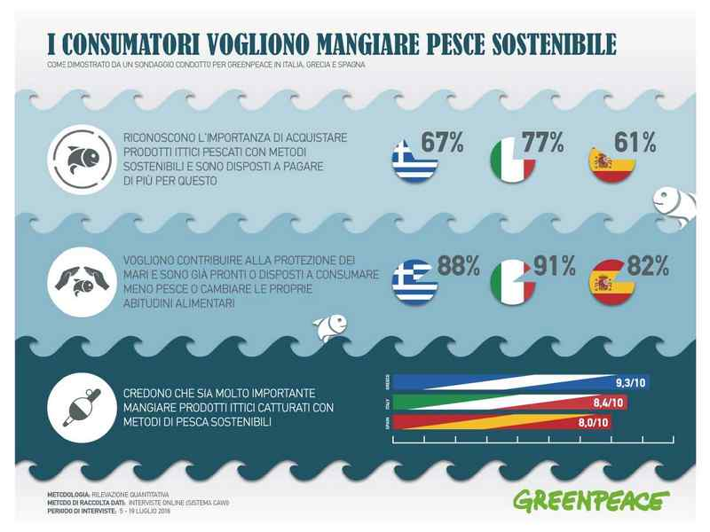
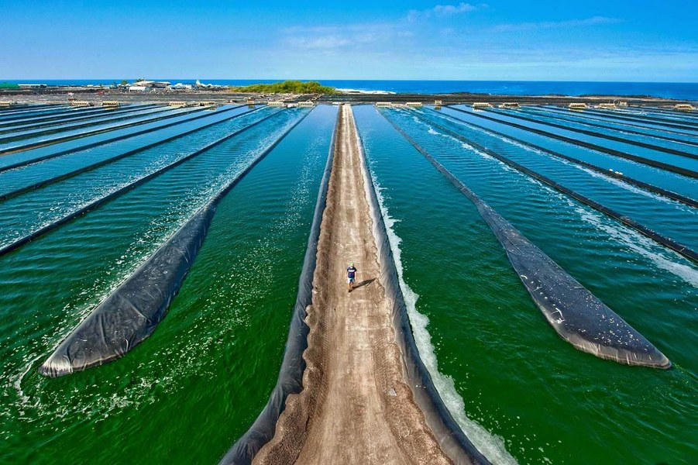
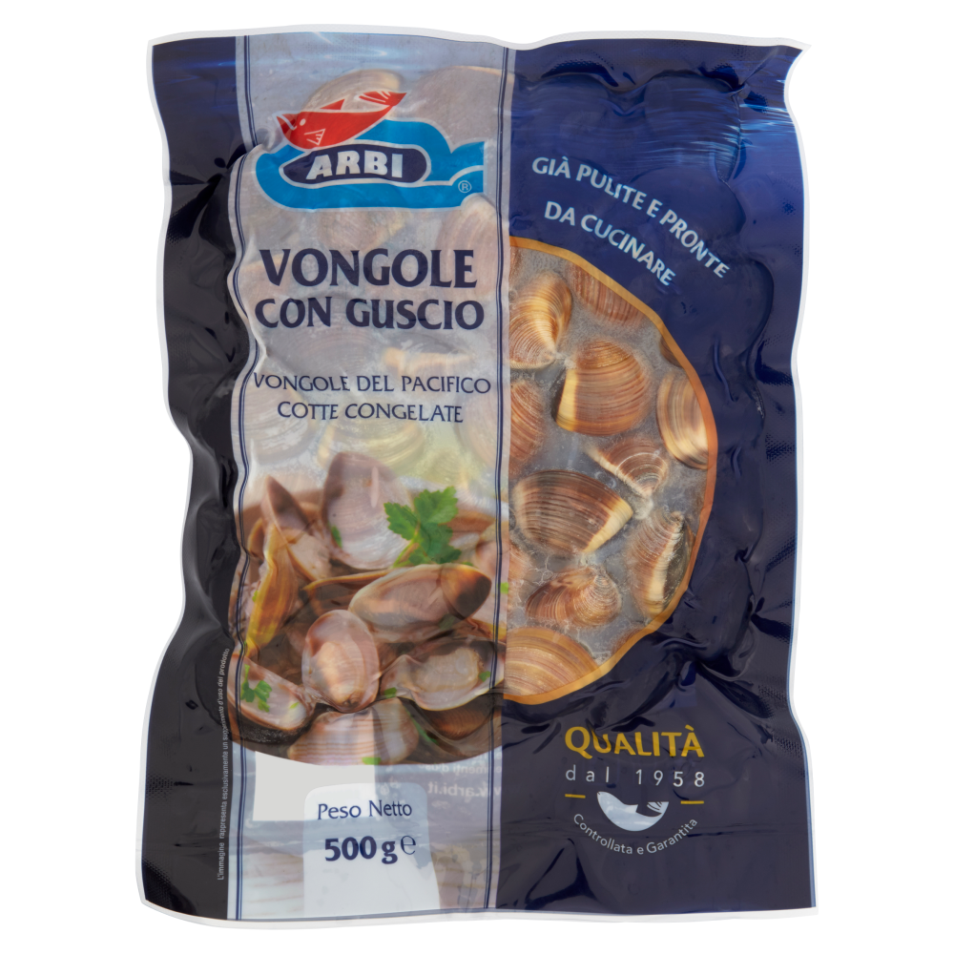

Slide 7
Caratterizzazione tossicologica dei Fattori di Potenza Relativa (RPF)
secondo SCHEER (2022) ed EFSA (2020)
PFAS | RPF SCHEER | RPF EFSA
PFBA | 0.05
PFPEA | 0.03
PFHxA | 0.01
PFHpA | 0.505
PFOA | 1 | 1
PFNA | 10 | 1
PFDA | 7
PFUNDA | 4
PFDOA | 3
PFTRDA | 1.65
PFTeDA | 0.3
PFXDA | 0.02
PFODA | 0.02
PFBS | 0.001
PFPeS | 0.3005
PFHxS | 0.6 | 1
PFHpS | 1.3
PFOS | 2 | 1
PFDS | 2
Gen X | 0.06
ADONA | 0.03
6:2 FTOH | 0.02
8:2 FTOH | 0.04
C6O4 | 0.06

Slide 8
PFAS | Clams¹ | Cuttle fish² | Crustacean² | Farmed seabream² | Clams | Cuttle fish | Crustacean | Farmed seabream
 | ng/kg | ng/kg | ng/kg | ng/kg | PFOA eq | PFOA eq | PFOA eq | PFOA eq
PFBA | <LOQ | <LOQ | <LOQ | <LOQ
PFPEA | <LOQ | <LOQ | <LOQ | <LOQ
PFHxA | <LOQ | <LOQ | <LOQ | <LOQ
PFHpA | 57 | <LOQ | <LOQ | <LOQ | 29
PFOA | 4832 | 20 | 36 | 14 | 4832 | 20 | 36 | 14
PFNA | 463 | 25 | 16 | < LOQ | 4630 | 253 | 155
PFDA | <LOQ | 854 | 51 | <LOQ |  | 5975 | 359
PFUNDA | 91 | 609 | 168 | <LOQ | 364 | 2434 | 673
PFDOA | <LOQ | 235 | 198 | <LOQ |  | 704 | 595
PFTRDA | 112 | 961 | 551 | 15 | 185 | 1585 | 909 | 24
PFTeDA | 44 | 143 | 139 | <LOQ | 13 | 43 | 42
PFXDA | <LOQ | <LOQ | NA | <LOQ
PFODA | <LOQ | <LOQ | NA | <LOQ
PFBS | <LOQ | <LOQ | <LOQ | <LOQ
PFPeS | <LOQ | <LOQ | <LOQ | <LOQ
PFHxS | 79 | <LOQ | <LOQ | <LOQ | 47
PFHpS | <LOQ | NA | NA | NA
PFOS | 200 | 598 | 443 | <LOQ | 400 | 1196 | 886
PFDS | NA | 13.6 | 11.1 | <LOQ |  | 27 | 22
Gen X | <LOQ | NA | NA | NA
ADONA | <LOQ | NA | NA | NA
6:2 FTOH | NA | NA | NA | NA
8:2 FTOH | NA | NA | NA | NA
C6O4 | NA | NA | NA | NA
¹ Dati FDA 2022 su prodotto importato; ² Dati progetto «Perfood»
Contaminazione nel prodotto ittico espressa in ng/kg PFOA equivalenti, secondo la griglia RPF SCHEER 2022

Slide 9
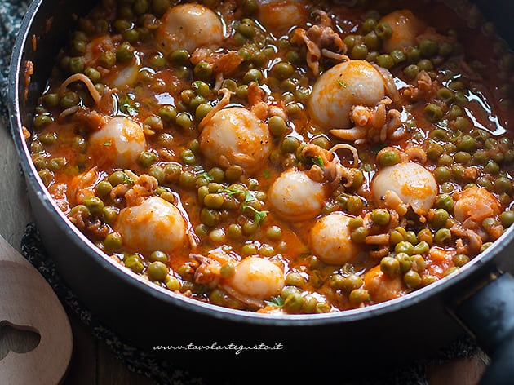
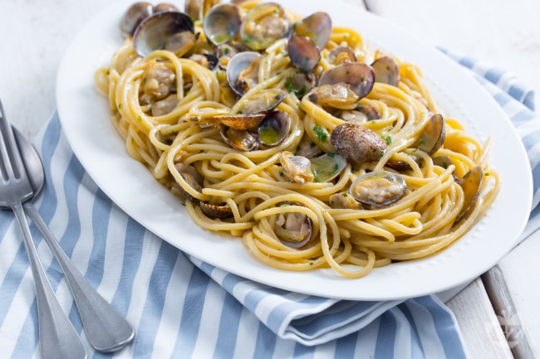
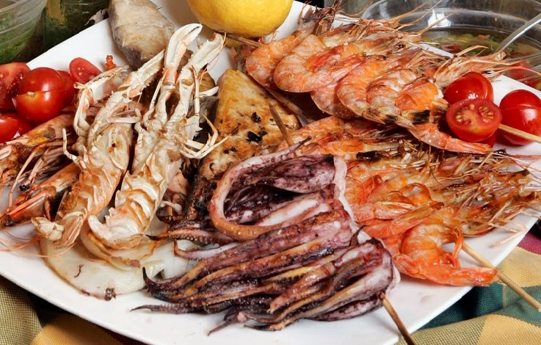
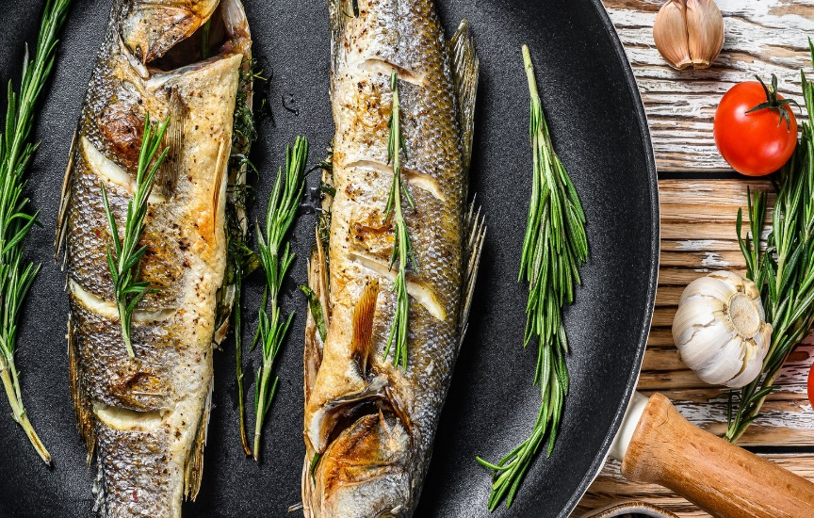
Consumi medi e P95 nella popolazione italiana adulta: ng/kg bw/giorno
(Dati EFSA – Food Consumption Database)
Seppie: 0,76 – 2,87
Vongole: 0,35 – 0,88
Crostacei: 0,54 – 1,37
Branzino: 1,48 – 3,11

Slide 10
PFAS | Clams |  |  |  | Cuttlefish |  |  |  | Crustaceans |  |  |  | Farmed seabass
 | SCHEER |  | EFSA |  | SCHEER |  | EFSA |  | SCHEER |  | EFSA |  | SCHEER |  | EFSA
 | mean | P95 | mean | P95 | mean | P95 | mean | P95 | mean | P95 | mean | P95 | mean | P95 | mean | P95
PFBA
PFPEA
PFHxA
PFHpA | 10 | 25
PFOA | 1691 | 4252 | 1691 | 4252 | 15 | 57 | 15 | 57 | 19 | 49 | 19 | 49 | 21 | 44 | 21 | 44
PFNA | 1621 | 4074 | 162 | 407 | 192 | 726 | 19 | 73 | 84 | 212 | 8 | 21
PFDA |  |  |  |  | 4541 | 17149 |  |  | 194 | 492
PFUNDA | 127 | 320 |  |  | 1850 | 6986 |  |  | 363 | 922
PFDOA |  |  |  |  | 535 | 2019 |  |  | 321 | 815
PFTRDA | 65 | 163 |  |  | 1205 | 4549 |  |  | 491 | 1246 |  |  | 36 | 75
PFTeDA | 5 | 12 |  |  | 33 | 123 |  |  | 23 | 57
PFXDA
PFODA
PFBS
PFPeS
PFHxS | 17 | 42 | 28 | 70
PFHpS
PFOS | 140 | 352 | 70 | 176 | 909 | 3433 | 455 | 1717 | 479 | 1214 | 239 | 607
PFDS | 0 | 0 |  |  | 21 | 78 |  |  | 12 | 30
Gen X
ADONA
6:2 FTOH | 0 | 0
8:2 FTOH | 0 | 0
C6O4 | 0 | 0
Σ PFOA eq | 3675 | 9240 | 1951 | 4905 | 9300 | 35119 | 489 | 1846 | 1986 | 5039 | 267 | 678 | 57 | 120 | 21 | 44
Intake come pg/kg/giorno

Slide 11
=
Stima di esposizione alimentare
-------------------------------------------
Valore Guida Tossicologico
Environmental Science and Pollution Research (2024) 31:33141–33147
TWI EFSA₂₀₂₀ = 4.4 ng/kg bw/week
( = TDI 0.63 ng/kg bw/day)

Slide 12
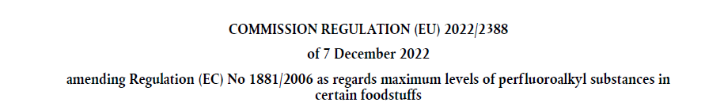
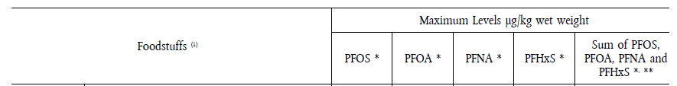
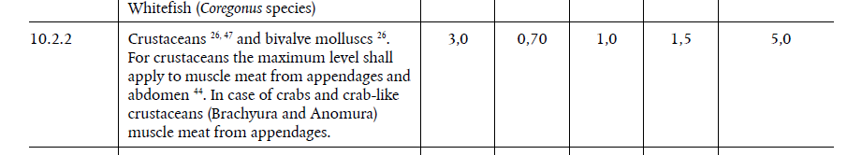
Mancano i molluschi cefalopodi e gasteropodi
(seppie, calamari, totani, polpi, moscardini, !!!

Slide 13
Piani di Campionamento per ricerca PFAS in alimenti - Italia

Slide 14

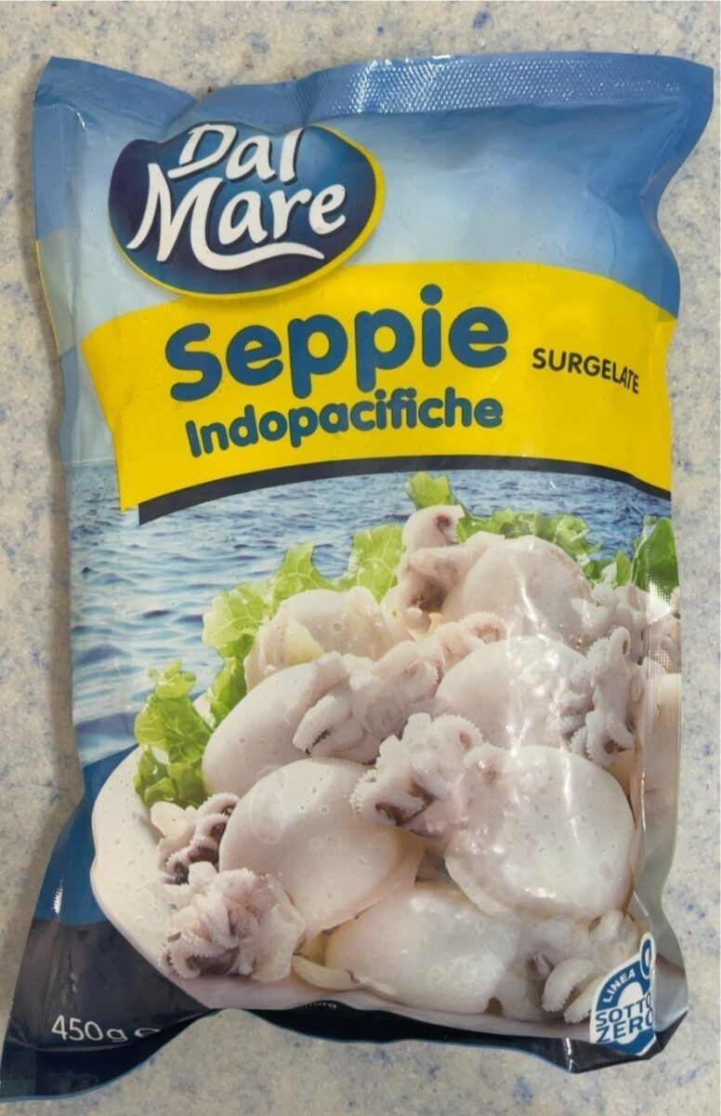
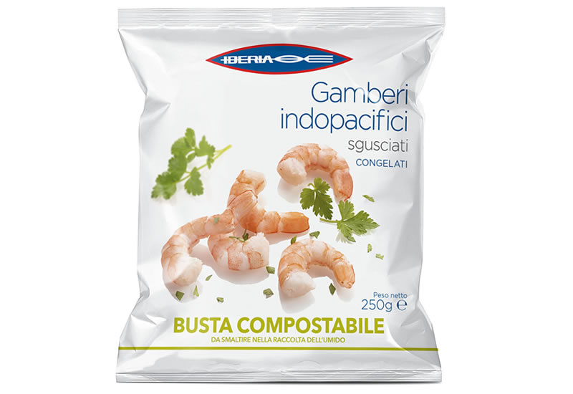
Original Constituent Update
July 6, 2022
Today, the U.S. Food and Drug Administration (FDA) made available testing results for per- and polyfluoroalkyl substances (PFAS) in seafood samples collected at retail. The FDA conducted this limited survey as a preliminary step to determine if a more targeted or larger seafood survey should be conducted. We tested 81 samples of clams, cod, crab, pollock, salmon, shrimp, tuna, and tilapia, most of which were imported to the United States. Using the best available science, the FDA evaluated individually the PFAS detected that have toxicological reference values. The FDA determined that the estimated exposure to perfluorooctanoic acid (PFOA), a type of PFAS, from the samples of canned clams, which were from China, is likely a health concern. For the canned clam samples with the two highest levels of PFOA, there would be a potential health concern for consumers who eat more than approximately 10 ounces (oz) (283 g) of these clams per month, except for young children, who should limit consumption to 2 oz (56,6 g) per month. ….
https://www.fda.gov/food/cfsan-constituent-updates/fda-shares-results-pfas-testing-seafood

Slide 15
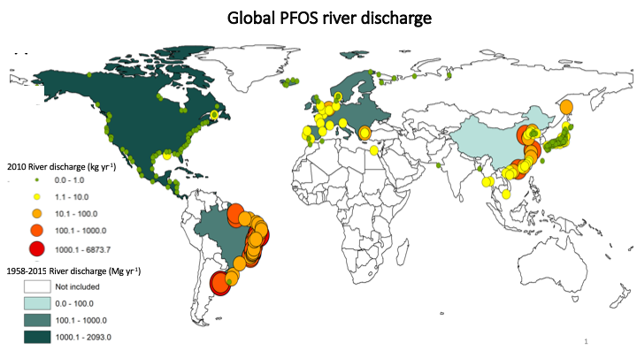
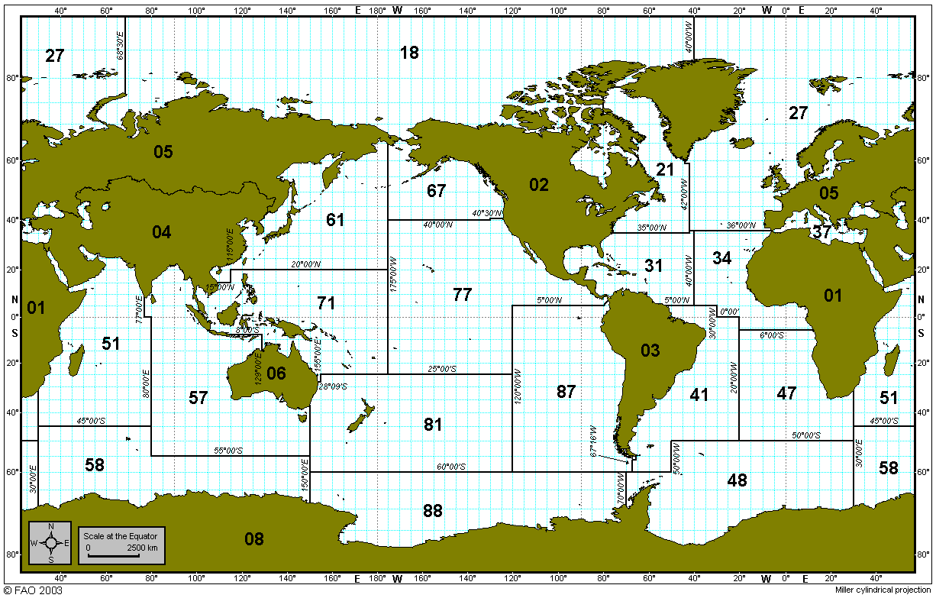

Slide 16
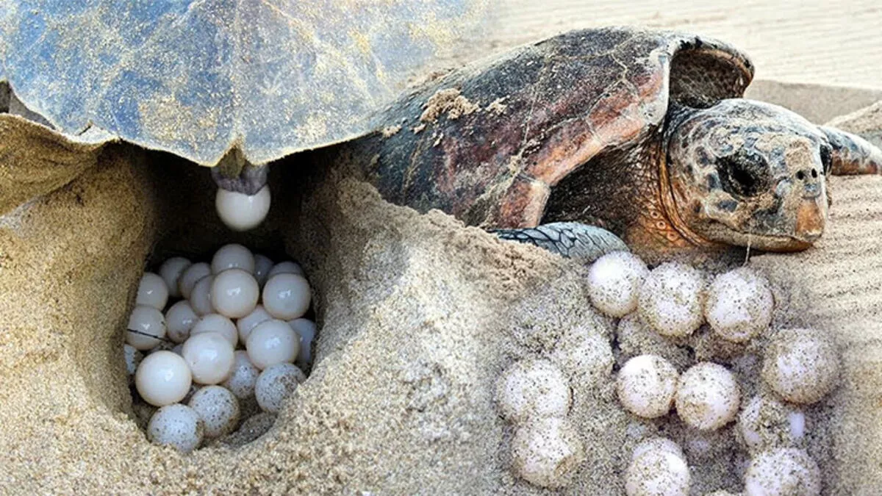
https://doi.org/10.1016/j.envpol.2023.123257

Slide 17
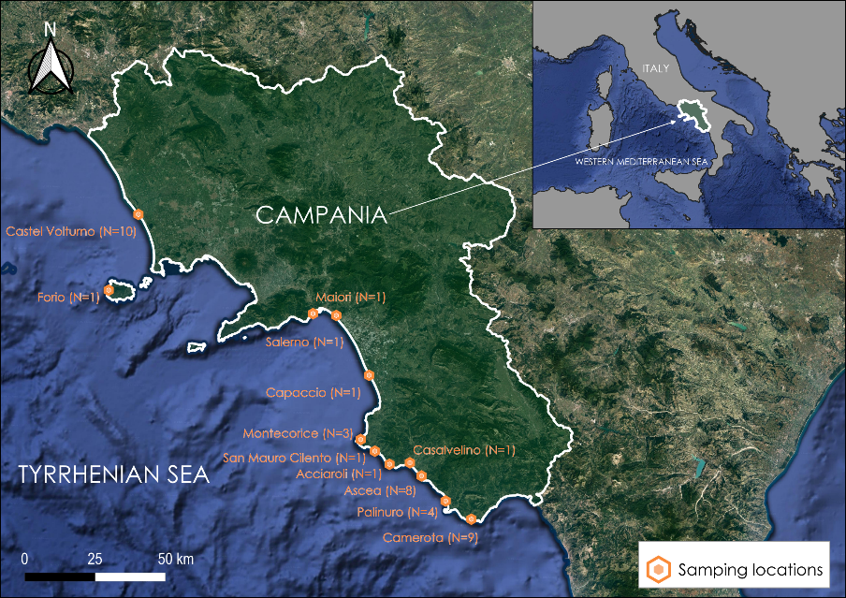
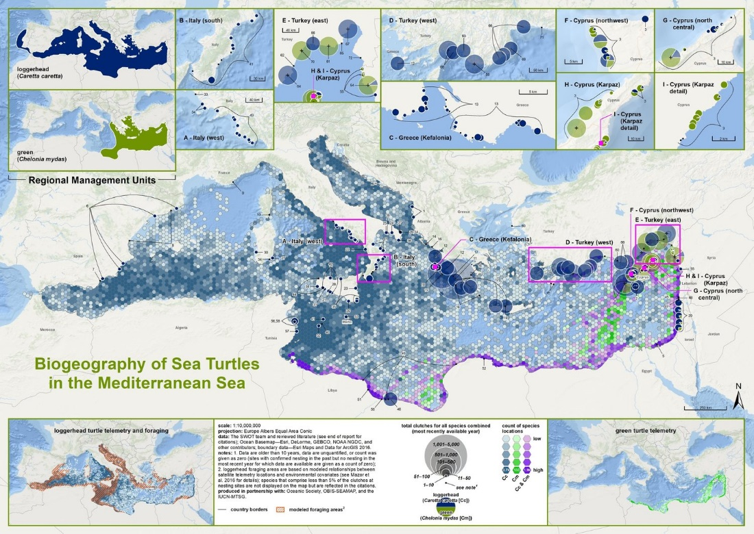
STUDIO OSSERVAZIONALE
https://www.seaturtlestatus.org/articles/2019/1/31/sea-turtles-of-the-mediterranean-sea

Slide 18
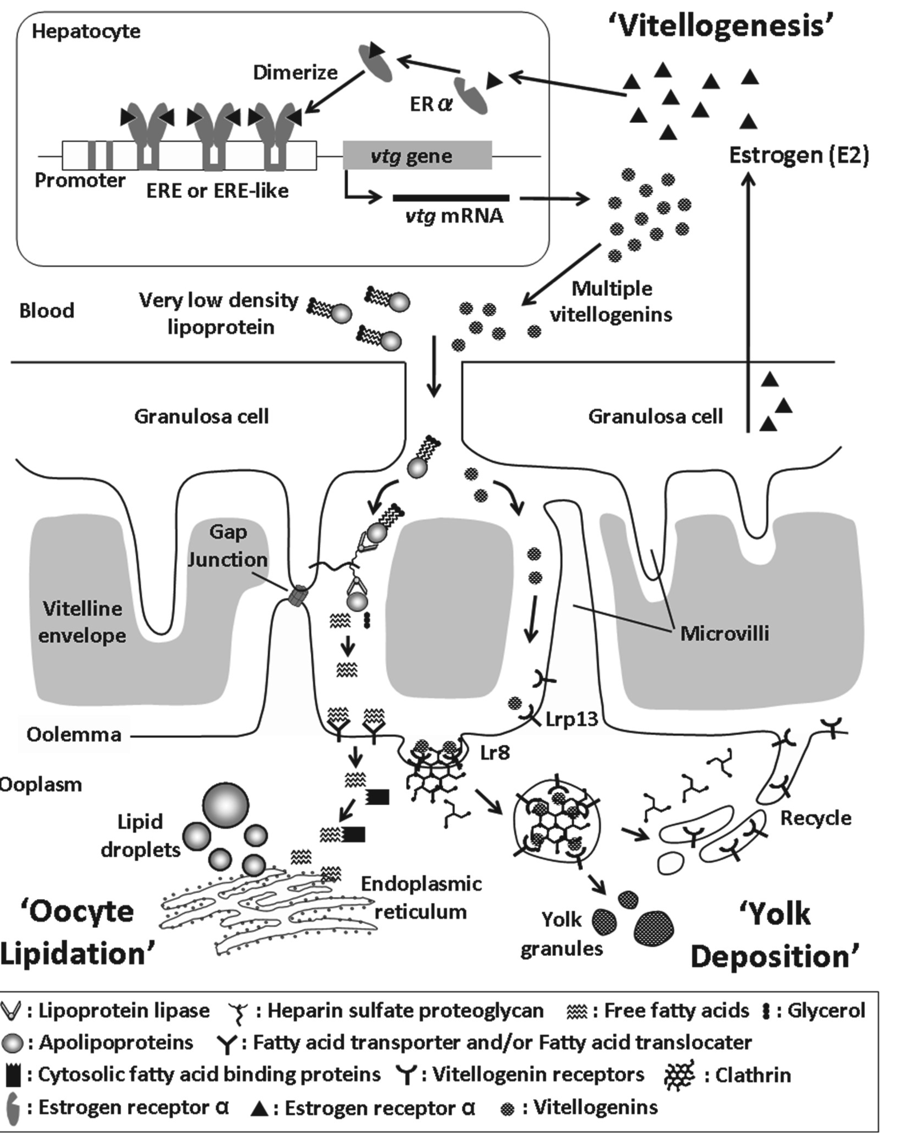
Ruolo della vitellogenina nel consegnare i PFAS all’oocita
Reading et al., doi:10.3390/fishes3040045
Tossicità dei PFAS a livello di acidi nucleici
Yuheng Qin et al., https://doi.org/10.1016/j.ecoenv.2023.115503

Slide 19
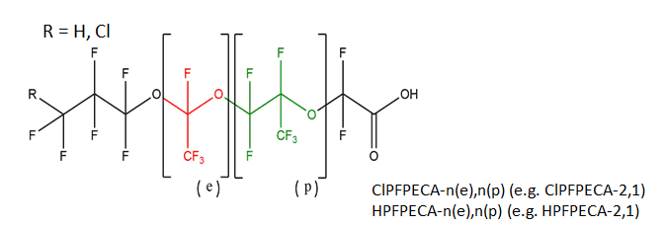
Risultati
Nests | Clutch size (N) |  | Hatching success (%)
N | mean | median | mean | median
41 | 84 | 70 | 71 | 93
 | PFBA | PFPEA | PFHXA | PFHPA | PFOA | PFNA | PFDA | PFUNA | PFDOA | PFTRIA | PFTETRA | PFHXDA
LOD (ppt) | 100 | 50 | 10 | 10 | 10 | 50 | 50 | 10 | 10 | 10 | 50 | 50
QD (%) | 0 | 0 | 10 | 10 | 34 | 100 | 100 | 100 | 100 | 100 | 90 | 0
median (ppt) | 0 | 0 | 0 | 0 | 0 | 200 | 300 | 420 | 160 | 400 | 90 | 0
 | PFBS | PFPES | PFHXS | PFOS | PFNS | PFDS | PFDOS
LOD (ppt) | 10 | 10 | 10 | 10 | 10 | 10 | 10
QD (%) | 5 | 27 | 56 | 100 | 0 | 1 | 0
median (ppt) | 10 | 0 | 10 | 1700 | 0 | 0 | 0
benthic forage habits
+
PFAS vitellogenin affinity
 | Chloro-Fluoro PolyEther Carboxilates
 | N2 (0,1) | M3 (1,1) | N3 (0,2) | N4 (0,3) | M4 (1,2) | N5 (2,2)
LOD (ppt) | 10 | 10 | 10 | 10 | 10 | 10
QD (%) | 17 | 15 | 34 | 15 | 0 | 0
mean (ppt) | 80 | 20 | 80 | 50 | 0 | 0
QD = Quantified Data

Slide 20
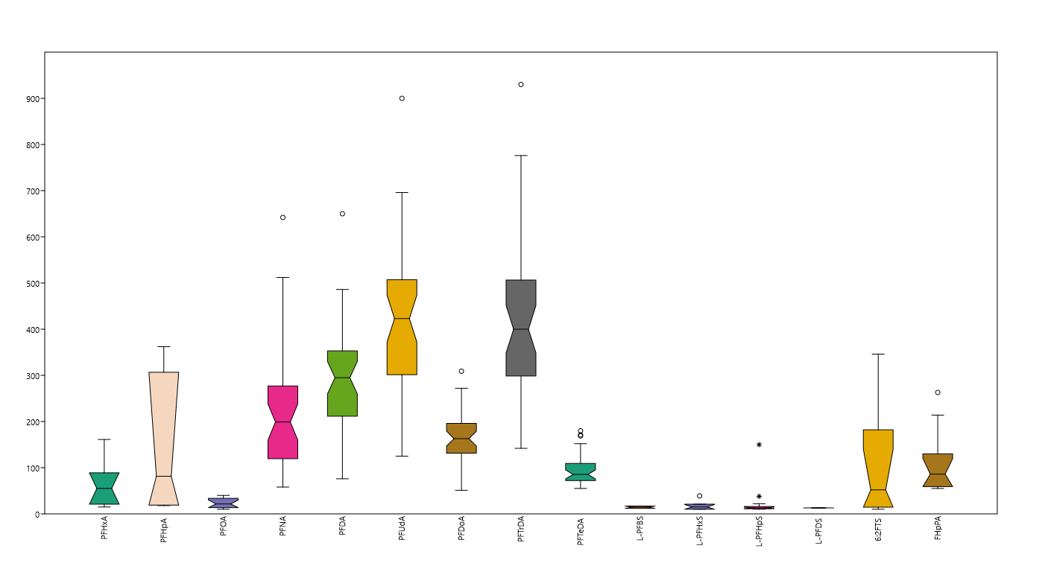
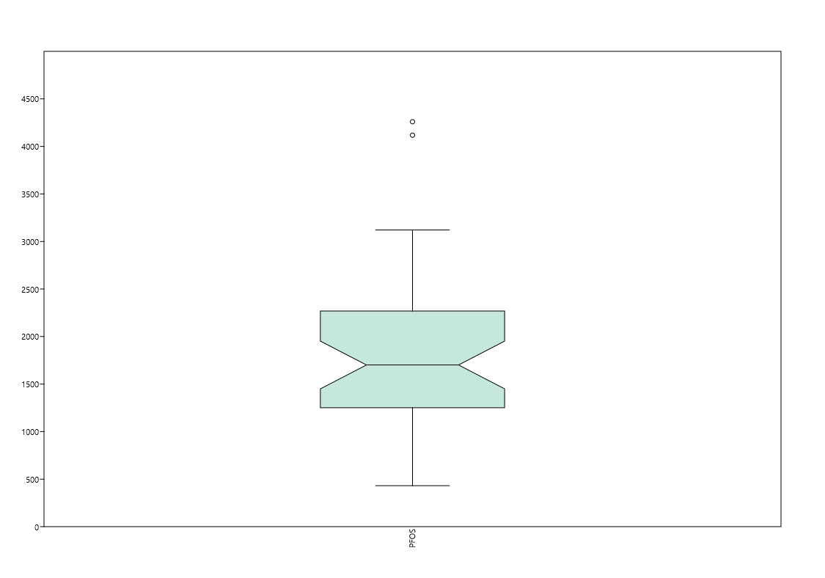
Risultati: legacy PFAS (ng/kg; ppt)
3000
2000
1000
PFOS
Concentration ng/kg
PFOS il più abbondante: media = 1810 ng/kg; mediana = 1701 ng/kg (~50% della somma dei PFAS determinati)
20 Marzo 2024, IZSM Portici
ª COMMISSION REGULATION (EU) 2023/915.

Slide 21
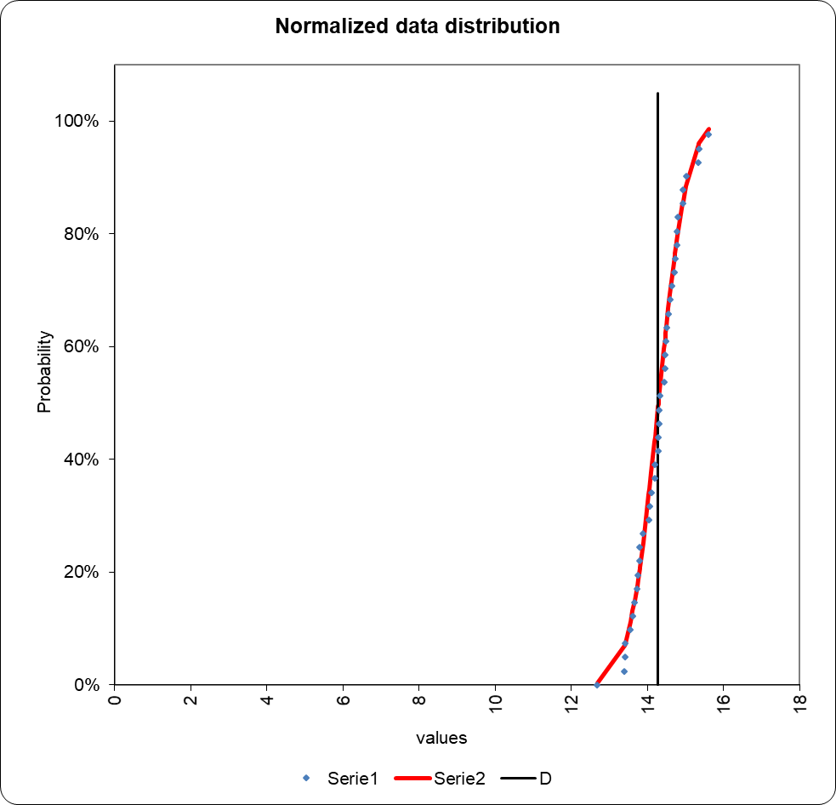
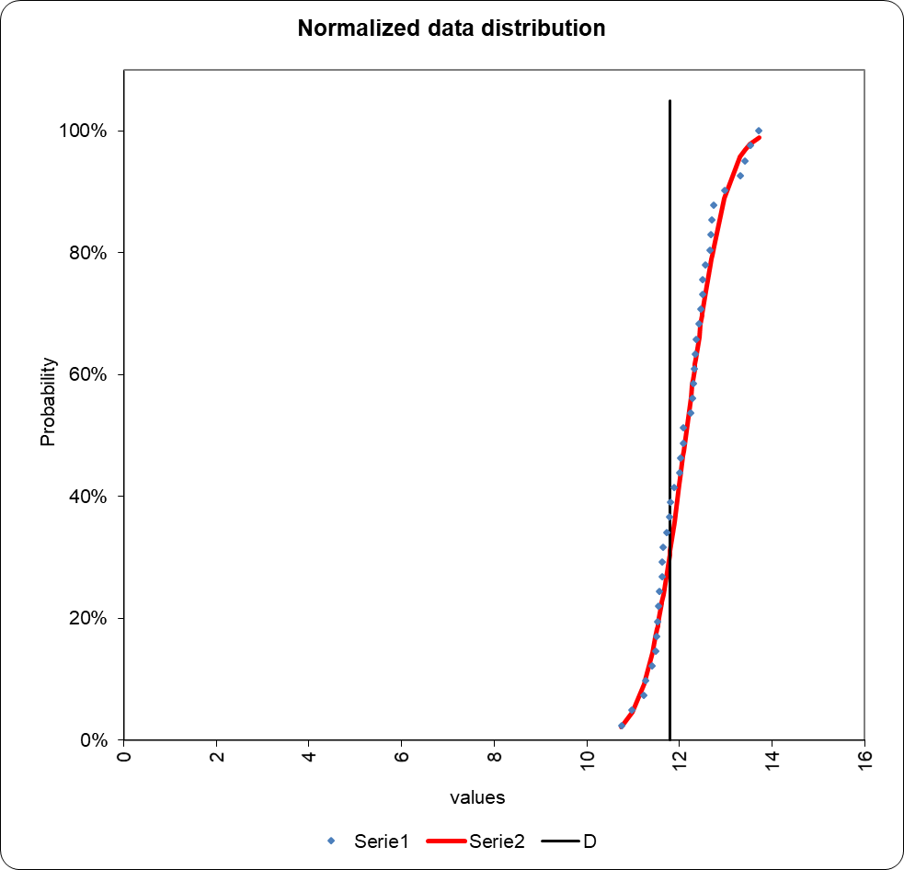
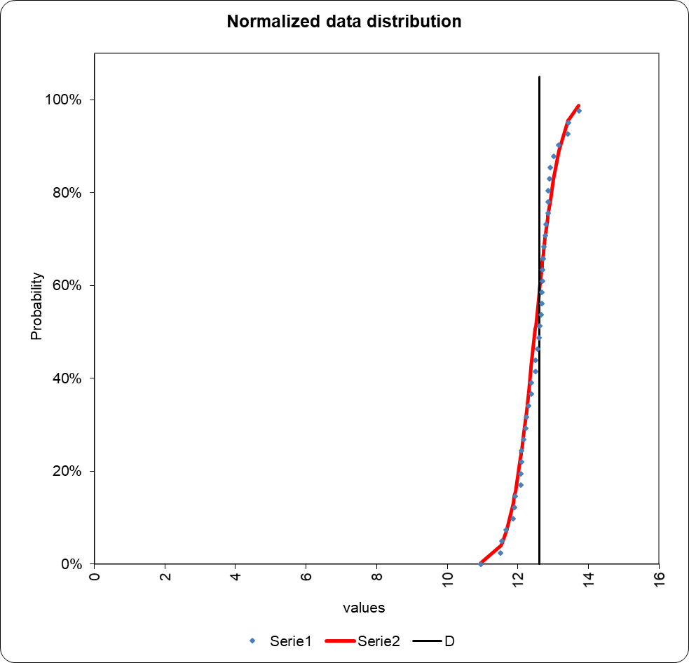
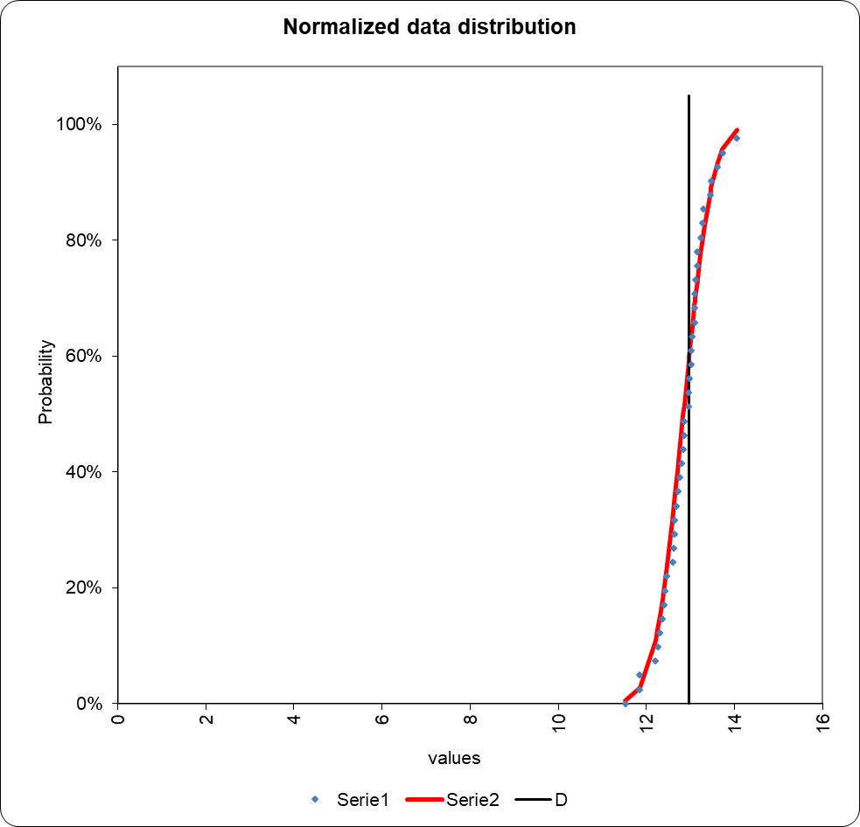
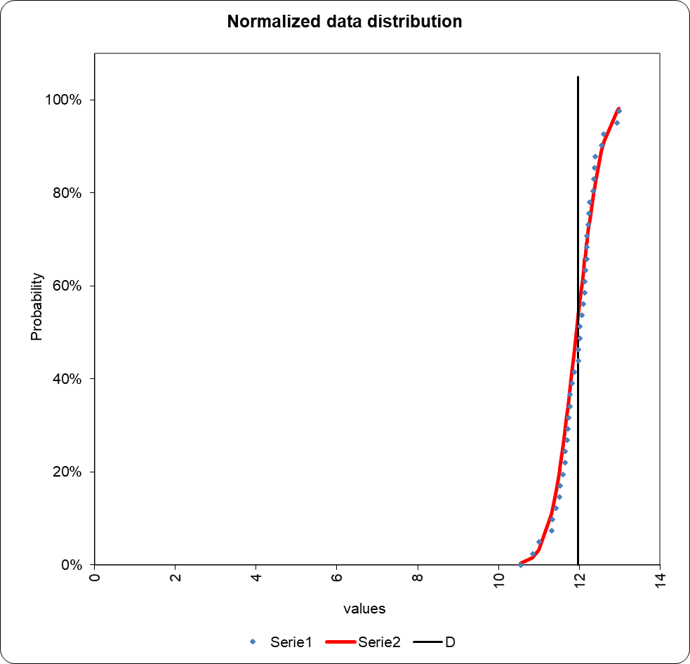
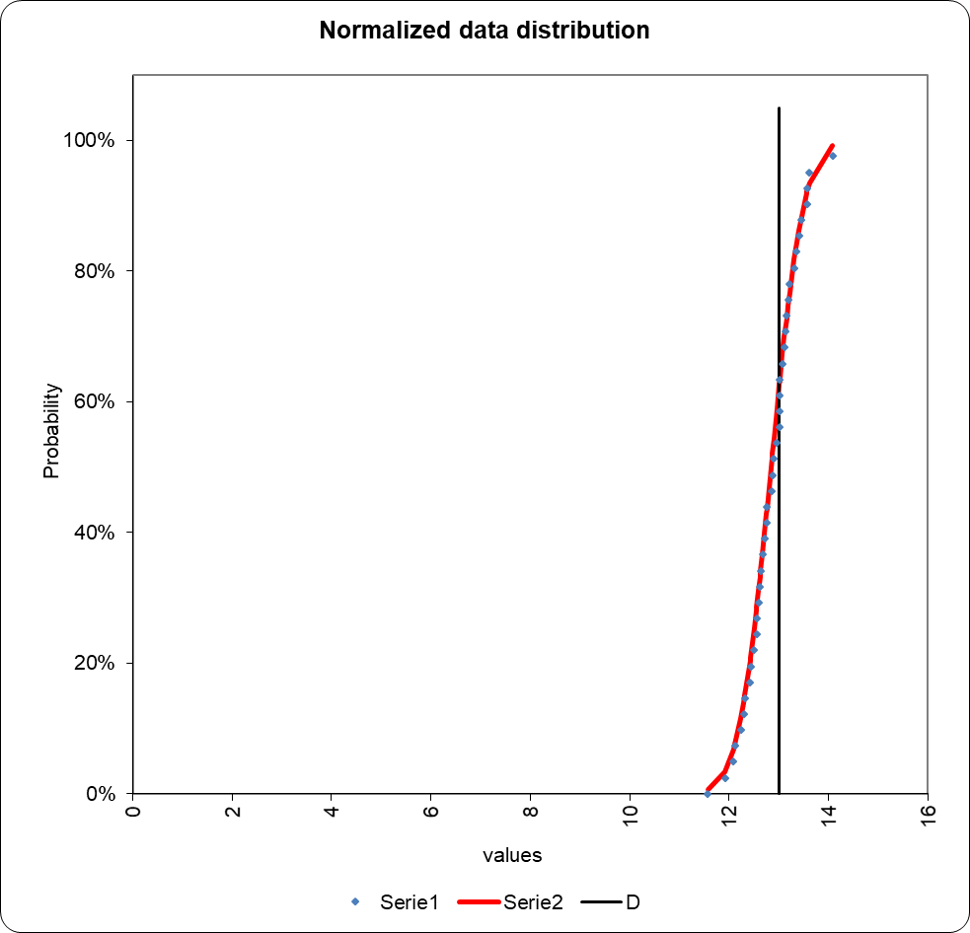
Log norm distribution
PFOS
PFNA
PFDA
PFUNA
PFDOA
PFTRiA
Outliers
PFOS Regression curve
PFAS Profiling

Slide 22
Conclusioni
I PFAS a lunga catena rientreranno a breve nell’ Annex A della Convenzione di Stoccolma; La loro presenza nei sedimenti marini non va sottovalutata:
Effetti sulla biodiversità, per tossicità riproduttiva e sulla disponibilità della risorsa marina (food security)
Bioaccumulo ed esposizione alimentare (food safety)
Opportunità di qualificare ambienti e risorsa ittica su base georeferenziata

